Slide 1
Sustainability and consumer choice of remedies: studying the moving target
Agnieszka Jabłonowska| 18 September 2024, Cambridge

Slide 2
Background
When a lack of conformity appears within a liability period, EU consumers can claim repair or replacement, according to their choice (Directive 2019/771).
Repair is typically the more sustainable remedy.
Directive 2024/1799: extended liability period after repair and relevant information to promote repair

Slide 3
Background
Extension of the liability period was not the preferred option in the impact assessment report (SWD(2023) 59 final).
Reason: other solutions, such as restricting consumer choice of remedies, were seen as more effective
Given the compromise reached, it is worth studying the ultimate solution in more detail: To what extent will it incentivize repair? Can the effect be strengthened and if so, how?
Consumer ID project x Empirical Legal Studies Leiden (Vanessa Mak, Helen Pluut)

Slide 4
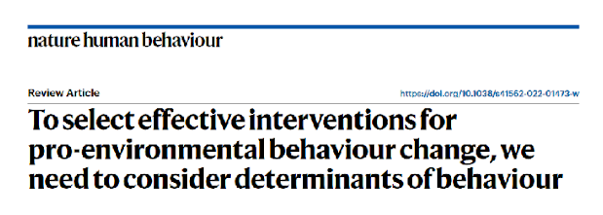
Insights from environmental psychology
Van Valkengoed et al. (2022) distinguish between six types of interventions and link them to specific determinants that motivate behaviour change.
Argument: interventions are more likely to be effective if they target the right set of determinants in a given context.

Slide 5
Insights from environmental psychology
The EU intervention can be classified as:
  an incentive (extension of the liability period)
  information about the non-environmental benefits associated with a behaviour (related information).
Hypothesis: providing additional information about the environmental consequences of choosing repair would lead more people to opt for this remedy.

Slide 6
Insights from environmental psychology
Why information about the environmental consequences of choosing repair makes sense?
Firstly, it could strengthen the effect of the two other interventions, both of which focus on attitudes.
The focus on attitudes makes sense under the Theory of Planned Behaviour, which posits that individual actions involve a cost-benefit analysis.

Slide 7
Insights from environmental psychology
Incentives
Attitudes
Information about non-environmental benefits of the behaviour
Attitudes

Slide 8
Insights from environmental psychology
Information about environmental consequences of a behaviour also affects attitudes.
Information about non-environmental benefits of the behaviour
Incentives
Information about environmental consequences of the behaviour
Attitudes

Slide 9
Insights from environmental psychology
Secondly, information about the environmental consequences of choosing repair targets not only attitudes but also other determinants.
As such, it makes sense under more than one theory explaining pro-environmental behaviour.
Problem awareness
Outcome efficacy
Ascription of responsibility
Information about environmental consequences of the behaviour
Attitudes
Personal norms
Self-focused emotions

Slide 10
Insights from environmental psychology
Prominent examples include the Norm Activation Model and the Value-Belief-Norm Theory, which focus e.g. on personal norms.
To embrace those other determinants means to acknowledge that there is more to human conduct than a cost-benefit analysis.
So, how to study if adding this piece of information really makes a difference?

Slide 11

Method: vignette experiment
A hypothetical scenario involving a purchase of a suitcase which became broken after purchase. The consumer brings the suitcase to the store and informs the seller of the non-conformity. In response, he or she is presented with options to have it repaired or replaced with a new one (same model).

Slide 12
Experimental manipulation
Three conditions:
no further information
information about the extension of the liability period in case of repair
information that the extension was introduced by law to reduce premature disposal of viable goods and therefore benefit the environment

Slide 13

Conclusions
Law and psychology offers a promising lens for studying behaviour change interventions and the associated consumer image
Vignette experiments make it possible to analyse a moving target, but come with limitations
Next steps: Consumer ID project

Slide 14
Thank you! a.a.jablonowska@law.leidenuniv.nl

