Slide 1


The Sustainable Lending Dilemma in the New Consumer Credit Directive:
Ensuring Social Justice in Consumer Credit Sales
Aleksandra Hyla, PhD candidate at the Adam Mickiewicz University, Poznań
Aleksandra Olbryk PhD candidate at the University of Lodz
1st European Conference of the International Association of Consumer Law
Girton College, Cambridge 17-18.9.2024

Slide 2
1st European Conference of the International Association of Consumer Law
Girton College, Cambridge 17-18.9.2024
Outline
What is sustainable lending, and why do consumers need it
How are sustainable lending and deferred payments connected
Why is the exemption introduced in Article 2(2)h of the CCD2 a problem from the perspective of sustainable lending
Solutions from the viewpoint of the EU and Polish law

Slide 3
1st European Conference of the International Association of Consumer Law
Girton College, Cambridge 17-18.9.2024
CCD2 promotes sustainable lending (recital 33)
We need a balance
between
economic growth
and
its environmental and social consequences

Slide 4
1st European Conference of the International Association of Consumer Law
Girton College, Cambridge 17-18.9.2024
A number of jurisdictions noted that deferred payment schemes risk over-indebtedness for consumers, who may not always understand
the risks they may incur when using this service.
Source: OECD, Consumer Finance Risk Monitor, OECD Publishing, Paris, 2024.

Slide 5
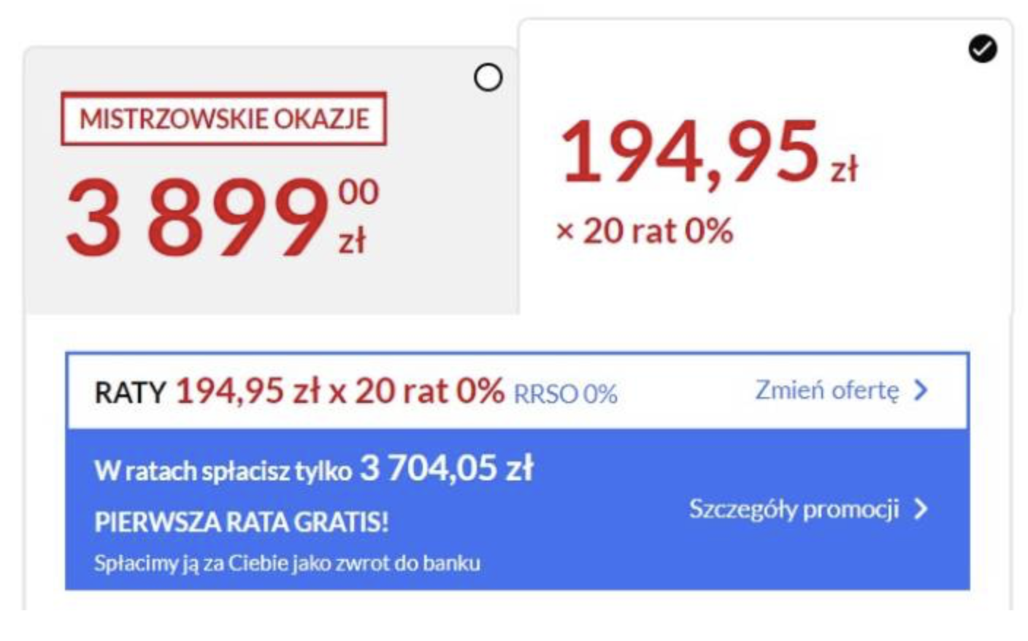
1st European Conference of the International Association of Consumer Law
Girton College, Cambridge 17-18.9.2024
Benefits:
1) Divided payment
2) Price reduction
Source: promotion valid in August 2024 in the Polish online store euro.com.pl

Slide 6
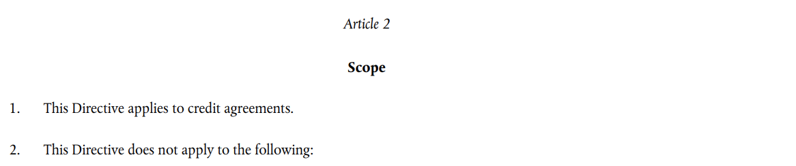
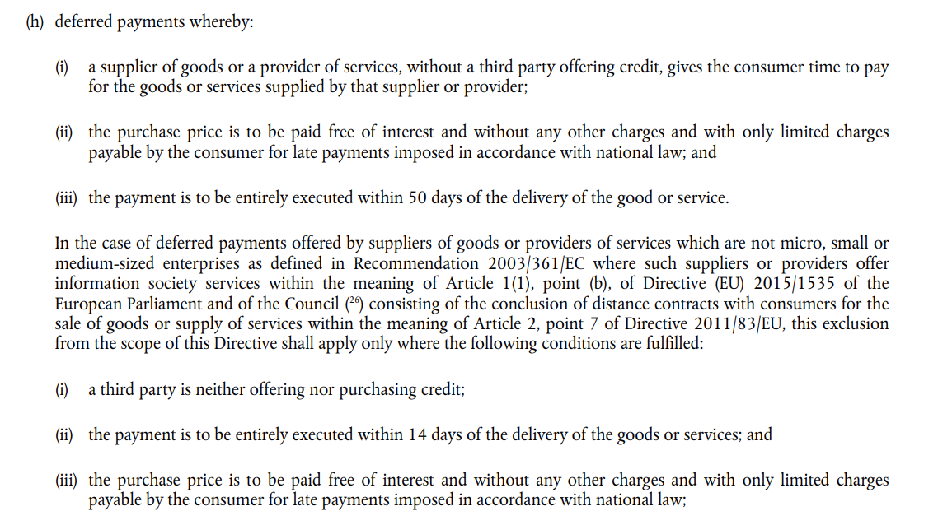
1st European Conference of the International Association of Consumer Law
Girton College, Cambridge 17-18.9.2024
Does not apply to suppliers who provide financing for the product themselves
A LOOPHOLE?

Slide 7
1st European Conference of the International Association of Consumer Law
Girton College, Cambridge 17-18.9.2024
Solutions in the European consumer law
UCPD
CRD
after the changes introduced by the Directive 2023/2673 on Distance Financial Services Contracts

Slide 8
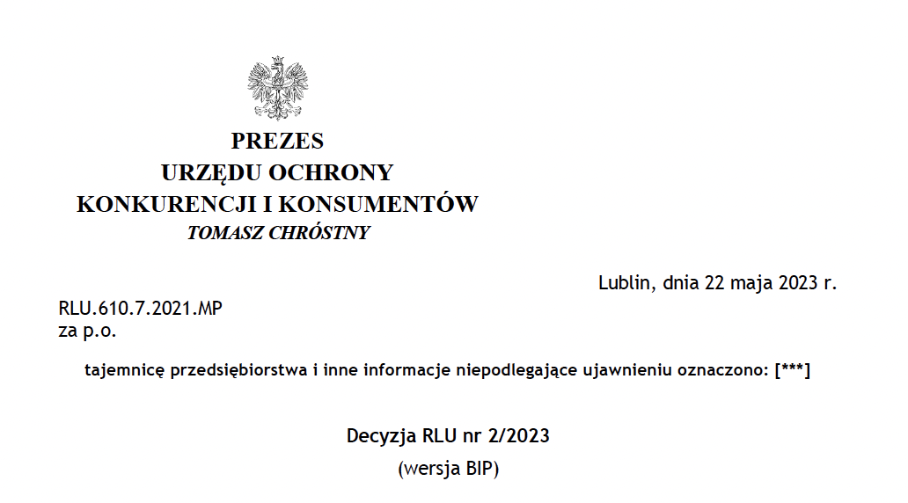
1st European Conference of the International Association of Consumer Law
Girton College, Cambridge 17-18.9.2024
The Polish approach

Slide 9

1st European Conference of the International Association of Consumer Law
Girton College, Cambridge 17-18.9.2024
Conclusions

Slide 10
Thank you for your attention!
Aleksandra Hyla: aleksandra.hyla@amu.edu.pl
Aleksandra Olbryk: aleksandra.olbryk@edu.uni.lodz.pl
1st European Conference of the International Association of Consumer Law
Girton College, Cambridge 17-18.9.2024

