Slide 1

FemTech Assets
Dr Asta Zokaityte
Kent Law School

Slide 2





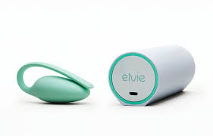
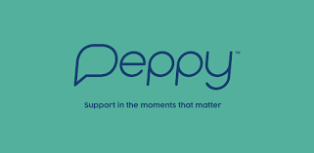


FemTech Ecosystem

Slide 3

FemTech → Closing The Health Inequality Gap?
Gendered Health Inequalities
Diagnosed later
More likely to suffer adverse drug reactions
Muslim women face additional barriers accessing mental health services
Chronic pain often attributed to psychological rather than somatic causes
BAME women more likely to die in childbirth
Lower cervical & breast cancer screening among BAME women

Slide 4
FemTech → Closing The Funding Gap?
overlooked by funding industry:
Femtech is a comparatively underfunded industry, accounting for only 1.4 per cent of aggregated capital that flows into the global healthcare industry, and only 3% of total HealthTech funding goes to FemTech
The absolute majority of venture capital funding (this includes our pension funding) over 90% goes to fund male innovators and all-male teams, while funding for women innovators and women-led teams account to 2% only
Women repeatedly report that women’s health products and issues are trivialised and reduced to niche markets when pitched to venture capitalists
Venture capital market is dominated by male venture capitalists – over 91% of investment decision-makers are men

Slide 5
Research Qs:
What ‘access’ does FemTech offer, for whom and where?
Assetisation shapes FemTech development: scalable & profitable
Assetisation shapes consumer access to FemTech
VC investments in FemTech 2018-2023:
general wellness care ($2.2 billion)
reproductive health ($1.1 billion)
family planning ($1.15 billion)
Compared to
chronic illness (only $17 million)
menopause ($83.8 million) (Dealroom, 2023).
Case study: 32 FemTech companies that received VC funding (AiVF, Aquafit, Gina Life, Illumigyn, Ocon Healthcare, Tulipon, Peequal, Amilis, Adora, Unfabled, Bea Fertility, Albatus Therapeutics, Hertility, Tuune, Verso Biosense, Viramal, Kasha, Grace Health, Whispa Health, Nabta Health, Flo, Clue, Natural Cycles, Ovia, Glow, Folx Health, Caria, Joylux, Kindbody, Elektra Health, Vira Health and Maven Clinic)

Slide 6
VC decision-making: deprioritising marginal healthcare needs
Because the market is too small, the company finally decided not to adapt the product for small children. That’s an example where companies know they could help, but won’t do it because of the market. This part is really saddening for an engineer…but from a business standpoint, it’s a niche and people and investors don’t want to go down that route. Thus, the government must find a system, to help develop those small markets (Lehoux et al., 2016, p. 381)

Slide 7

Thank you

