Slide 1

1st European Conference of the International Association of Consumer Law
Girton College – University of Cambridge
17-18 September 2024
Financial Exclusion of Consumers suffering from Digital Divide
Hervé Jacquemin
Professor at the University of Namur (Belgium), CRIDS/NADI
Member of the Brussels Bar

Slide 2
Digital Divide
Concept
  Lack of access to the internet or digital technologies
  Insufficient digital skills to make use of technologies and online services
    Information and data literacy skills
    Communication and collaboration skills
    Digital content creation skills
    Safety skills
    Problem solving skills
Relevance of socio-demographic characteristics (age, education, income, etc.)

Slide 3
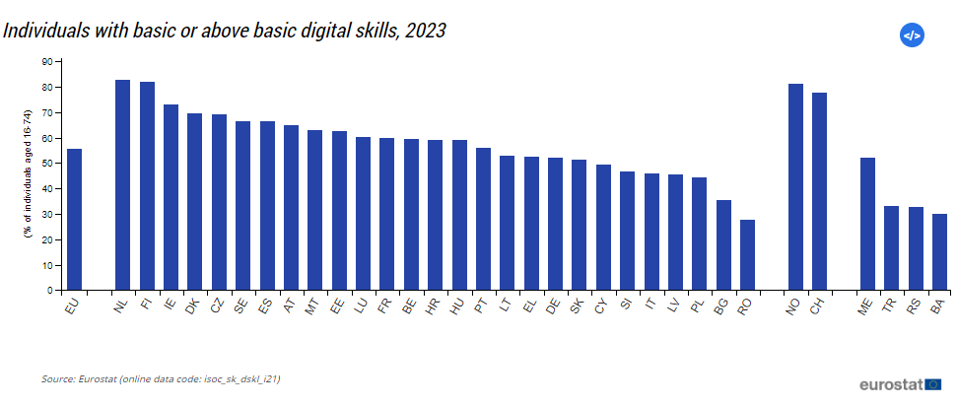
Digital Divide
In 2023, 56% of EU citizens (16-74) had at least basic digital skills (target = 80% in 2030)

Slide 4
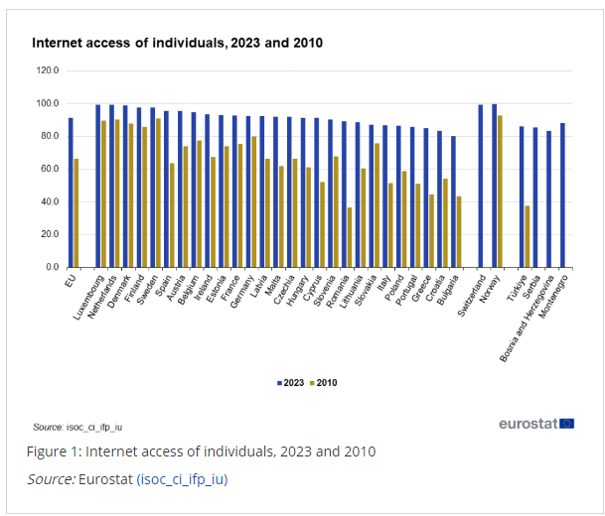
Digital Divide
91% of internet users in 2023 (comp. 67% in 2010)

Slide 5
Digital divide → financial exclusion?
Consumers victims of the digital divide may also be excluded from financial services (insurance, banking, credit, investment, payments, etc.) or forced to used them under less competitive conditions
  Use of digital technologies is indeed indispensable for various financial services:
    electronic payments (excluding cash payments) may be preferred (and sometimes the only ones available);
    Financial services can (or even must) be subscribed to via a website or mobile application;
    the only means of communication available are electronic (email, chatbot or online form);
    Etc.

Slide 6
Question?
Is there a right for consumers not to use digital technology:
to perform legal acts in the financial sector (e.g. conclude, amend or terminate a contract)? or
to communicate with financial services providers?
sector-specific rules (1.)
transversal rules (2.)
  …allowing consumers not to use digital technology

Slide 7
1. Sector specific rules allowing consumers not to use digital technology
Access to security mesures
  Art. 5b (15) of Regulation (UE) 910/2014 on electronic identification and trust services (eIDAS), as amended by Regulation (EU) 2024/1183 – European Digital Identity Wallet :
    “The use of European Digital Identity Wallets shall be voluntary. Access to public and private services, access to the labour market and freedom to conduct business shall not in any way be restricted or made disadvantageous to natural or legal persons that do not use European Digital Identity Wallets. It shall remain possible to access public and private services by other existing identification and authentication means”
  Art. 88 of the proposal for a Regulation on payment services
    “(1) Without prejudice to the accessibility requirements under Directive (EU) 2019/882, payment service providers shall ensure that all their customers, including persons with disabilities, older persons, with low digital skills and those who do not have access to digital channels or payment instruments, have at their disposal at least a means, adapted to their specific situation, which enables them to perform strong customer authentication”
    “(2) Payment services providers shall not make the performance of strong customer authentication dependant on the exclusive use of a single means of authentication and shall not make the performance of strong customer authentication depend, explicitly or implicitly, on the possession of a smartphone. Payment services providers shall develop a diversity of means for application of strong customer authentication to cater for the specific situation of all their customers”

Slide 8
1. Sector specific rules allowing consumers not to use digital technology
Non-electronic means of communications?
  Art. 5 (3) of the Directive 2002/65/EC on distance marketing of consumer financial services :
    “At any time during the contractual relationship the consumer is entitled, at his request, to receive the contractual terms and conditions on paper. In addition, the consumer is entitled to change the means of distance communication used, unless this is incompatible with the contract concluded or the nature of the financial service provided”
    Comp. DIR 2023/2673?
  Art. 88 of the directive 2016/97/CE on insurance distribution contracts
    As a matter of principle, all information shall be communicated on paper and free of charge
    By way of derogation, it may be communicated on a durable medium other than paper or on a website, where specific conditions are met

Slide 9
1. Sector specific rules allowing consumers not to use digital technology
Electronic payment or cash?
  At the EU level:
    Improve access to cash is a priority of the Commission → retailers should be allowed to offer cash provision services in physical shops (Art. 38 of the proposal for a directive on payment services and electronic money – PSD3)
  At the national level (e.g. Belgium):
    Companies shall accept electronic payments and cash from consumers, with limited exceptions (Art. VI.7/4 and VI.7/5 of the Belgian Code of Economic Law)

Slide 10
2. Transversal rules allowing consumers not to use digital technology
Prohibition of unfair commercial practices (DIR 2005/29/EC)
  Prohibition of misleading and aggressive commercial practices (art. 6 et seq.)
  Prohibition of unfair commercial practices under Article 5.
    But : Reference to the « average consumer »
    Or : assessment from the perspective of the average member of the group (vulnerable group of consumers)

Slide 11
2. Transversal rules allowing consumers not to use digital technology
Prohibition of discriminations
  Cf. Charter of fundamental rights of the European Union :
    Equality before the law (Art. 20) ; non-discrimination (Art. 21)
    Freedom to conduct a business (Art. 16)
  Cf. sector-specific directives
European Declaration on Digital Rights and Principles for the Digital Decade (2022)
  Connectivity
  Digital education and skills
  Fair online environment

Slide 12
2. Transversal rules allowing consumers not to use digital technology
Art. XII.25 (1) of the Belgian Code of Economic Law: « no one may be compelled to perform a legal act by electronic means »
  B2G relationships only?
  Legal acts?
  Only in connection with trust services?

Slide 13
Conclusion
Current legal framework should be amended
Need of new transversal rules protecting citizens and consumers

Slide 14
Thanks for your attention!
Questions?
herve.jacquemin@unamur.be

