Slide 1
Protecting consumers against their poison: Defects in digital content and digital services
Professor Joasia Luzak

Slide 2
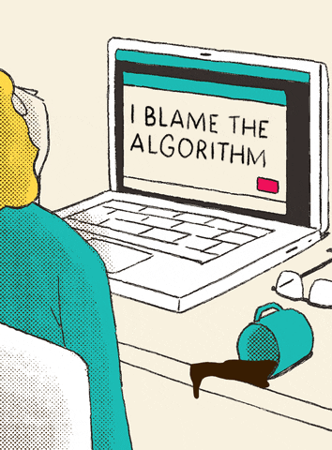
Outline
Limited scope of the new rules
Concept of defect in the digital world
Digital defects’ impact on consumers
https://media.giphy.com/media/v1.Y2lkPTc5MGI3NjExb3FrNnZzZW8xdWJ1MzFjbW9oNXdhOTE1b3N6bHZjcG5pcmMzMGhuciZlcD12MV9pbnRlcm5hbF9naWZfYnlfaWQmY3Q9Zw/zMukICnMEZmSf8zvXd/giphy.gif

Slide 3
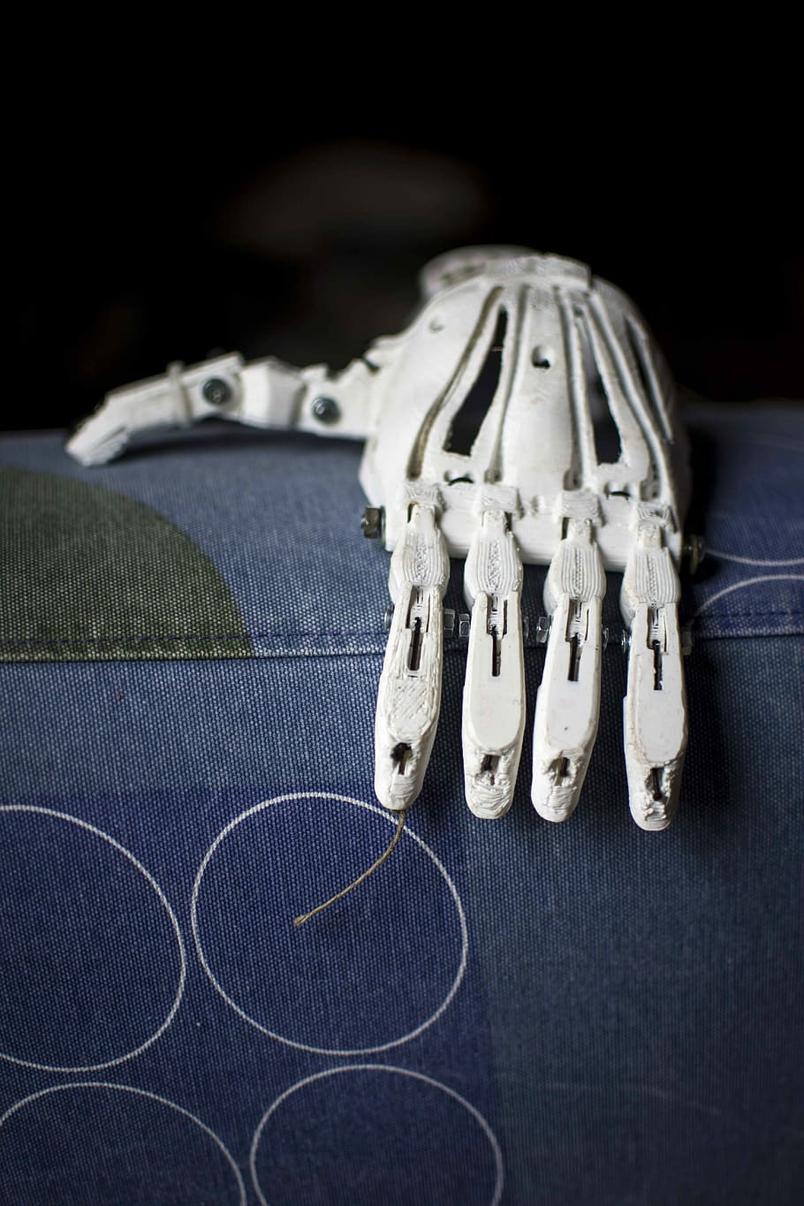
Digital components as products? Limited scope
Art. 4(1) & Recital 13: Software as a product
    NOT information contained in or a source of digital content
Art. 4(1) & Recital 16: Digital manufacturing files as a product
    Computer-assisted-design file used to create a 3D-printed good that causes harm
    NOT digital files
Art. 4(3) & Recital 17: Integrated or interconnected digital services – limited scope for ‘related services’
  Of essence + manufacturer’s control
    Continuous supply of traffic data in a navigation system
    Health monitoring service relying on physical product’s sensors to track the user’s physical activity (…)
    Voice-assistant service allowing products to be controlled by using voice commands

Slide 4
Concept of defect in the digital world

Slide 5

Defective product and defectiveness
Art. 6 Directive 85/374/EEC – ‘defective’
  Not providing safety which a person is entitled to expect
Art. 6 COM(2022) 495 final – ‘defectiveness’
  Not providing safety which the public at large is entitled to expect
  Recital 22 – objective, legitimate expectations
Art. 7 of text adopted by EP on 12 March 2024
  Not providing safety which a person is entitled to expect or that is required by EU or national law
  https://media.giphy.com/media/v1.Y2lkPTc5MGI3NjExcmF2bzFsMHlhdTQweHF5ZDN4a2Fqb2c2d2F4a3Q1a2NsaDd2YTdidSZlcD12MV9pbnRlcm5hbF9naWZfYnlfaWQmY3Q9Zw/2zoFg7OGkcS82CPK44/giphy.gif

Slide 6

All (digital) circumstances – Art. 7(2)
Self-learning functions
  Effect on the product of any ability to continue to learn or acquire new features after it is placed on the market or put into service
  Prevention of hazardous product behaviour paramount
Interconnectedness
  Reasonably foreseeable effect on the product of other products that can be expected to be used together, incl. by means of interconnection
Relevant product safety requirements, incl. safety-relevant cybersecurity
This Photo by Unknown Author is licensed under CC BY-NC-ND

Slide 7

Updates
Art. 11(2) – defect caused by update or by lack of update to maintain safety not exempts from liability
Within manufacturer’s control (Art. 4(5)(a) and (b) and Recital 18) when manufacturer:
  integrates or interconnects software updates or upgrades, or
  authorises or consents to their integration or supply
  Insufficient to provide technical possibility of integration or to make recommendations for it
Evolving cybersecurity risks place responsibility throughout the product’s lifecycle for security updates (Recital 51)
This Photo by Unknown Author is licensed under CC BY-SA-NC

Slide 8
Digital defect’s impact on consumers

Slide 9

Damage – Art. 6 (1)(a) and (2)
Death or personal injury (Recital 21)
  Incl. medically recognised and certified damage to psychological health that affects the victim’s general state of health and could require therapy or medical treatment
Rules on calculating compensation and providing compensation for non-material losses (Recital 23)
  Left to national law
Pain and suffering because of defective digital products left unharmonised
https://media.giphy.com/media/v1.Y2lkPTc5MGI3NjExdGJxbWRqdnpxd21jdW51NmN1d3gzYzdudDB0NzVrZHoybTQ2bGQybyZlcD12MV9pbnRlcm5hbF9naWZfYnlfaWQmY3Q9Zw/lq3imcwTI2VeevAcIz/giphy.gif

Slide 10

Damage – Art. 6(1)(c)
Property damage
  Defective digital components leading to damage of a product in which they are integrated – not covered
Destruction or corruption of data
  Not used for professional purposes
    Incl. cost of recovering or restoring data (Recital 20)
    Excl. damage resulting from leakage of data or breaches of data protection rules (Recital 20)
      Regulated by Art. 82 GDPR
    Excl. harm resulting from privacy infringements (Recital 24)
Relevant for online environment
  Excl. harm resulting from discrimination (Recital 24)
  https://media.giphy.com/media/v1.Y2lkPTc5MGI3NjExZmpldGx2M2RmeXU3ZTZ4aWlhcGEwNGJyc2Q1ZmNjbmplajlyeGdqbSZlcD12MV9pbnRlcm5hbF9naWZfYnlfaWQmY3Q9Zw/G1ifnX4d5tYFACktp9/giphy.gif

Slide 11
Thank you. j.luzak@exeter.ac.uk

