Slide 1


The long and winding road to the greener consumer law: adopting protection-by-information for environmental purposes
dr Katarzyna Południak-Gierz
1st European Conference of
the International Association of Consumer Law
Girton College, University of Cambridge

Slide 2
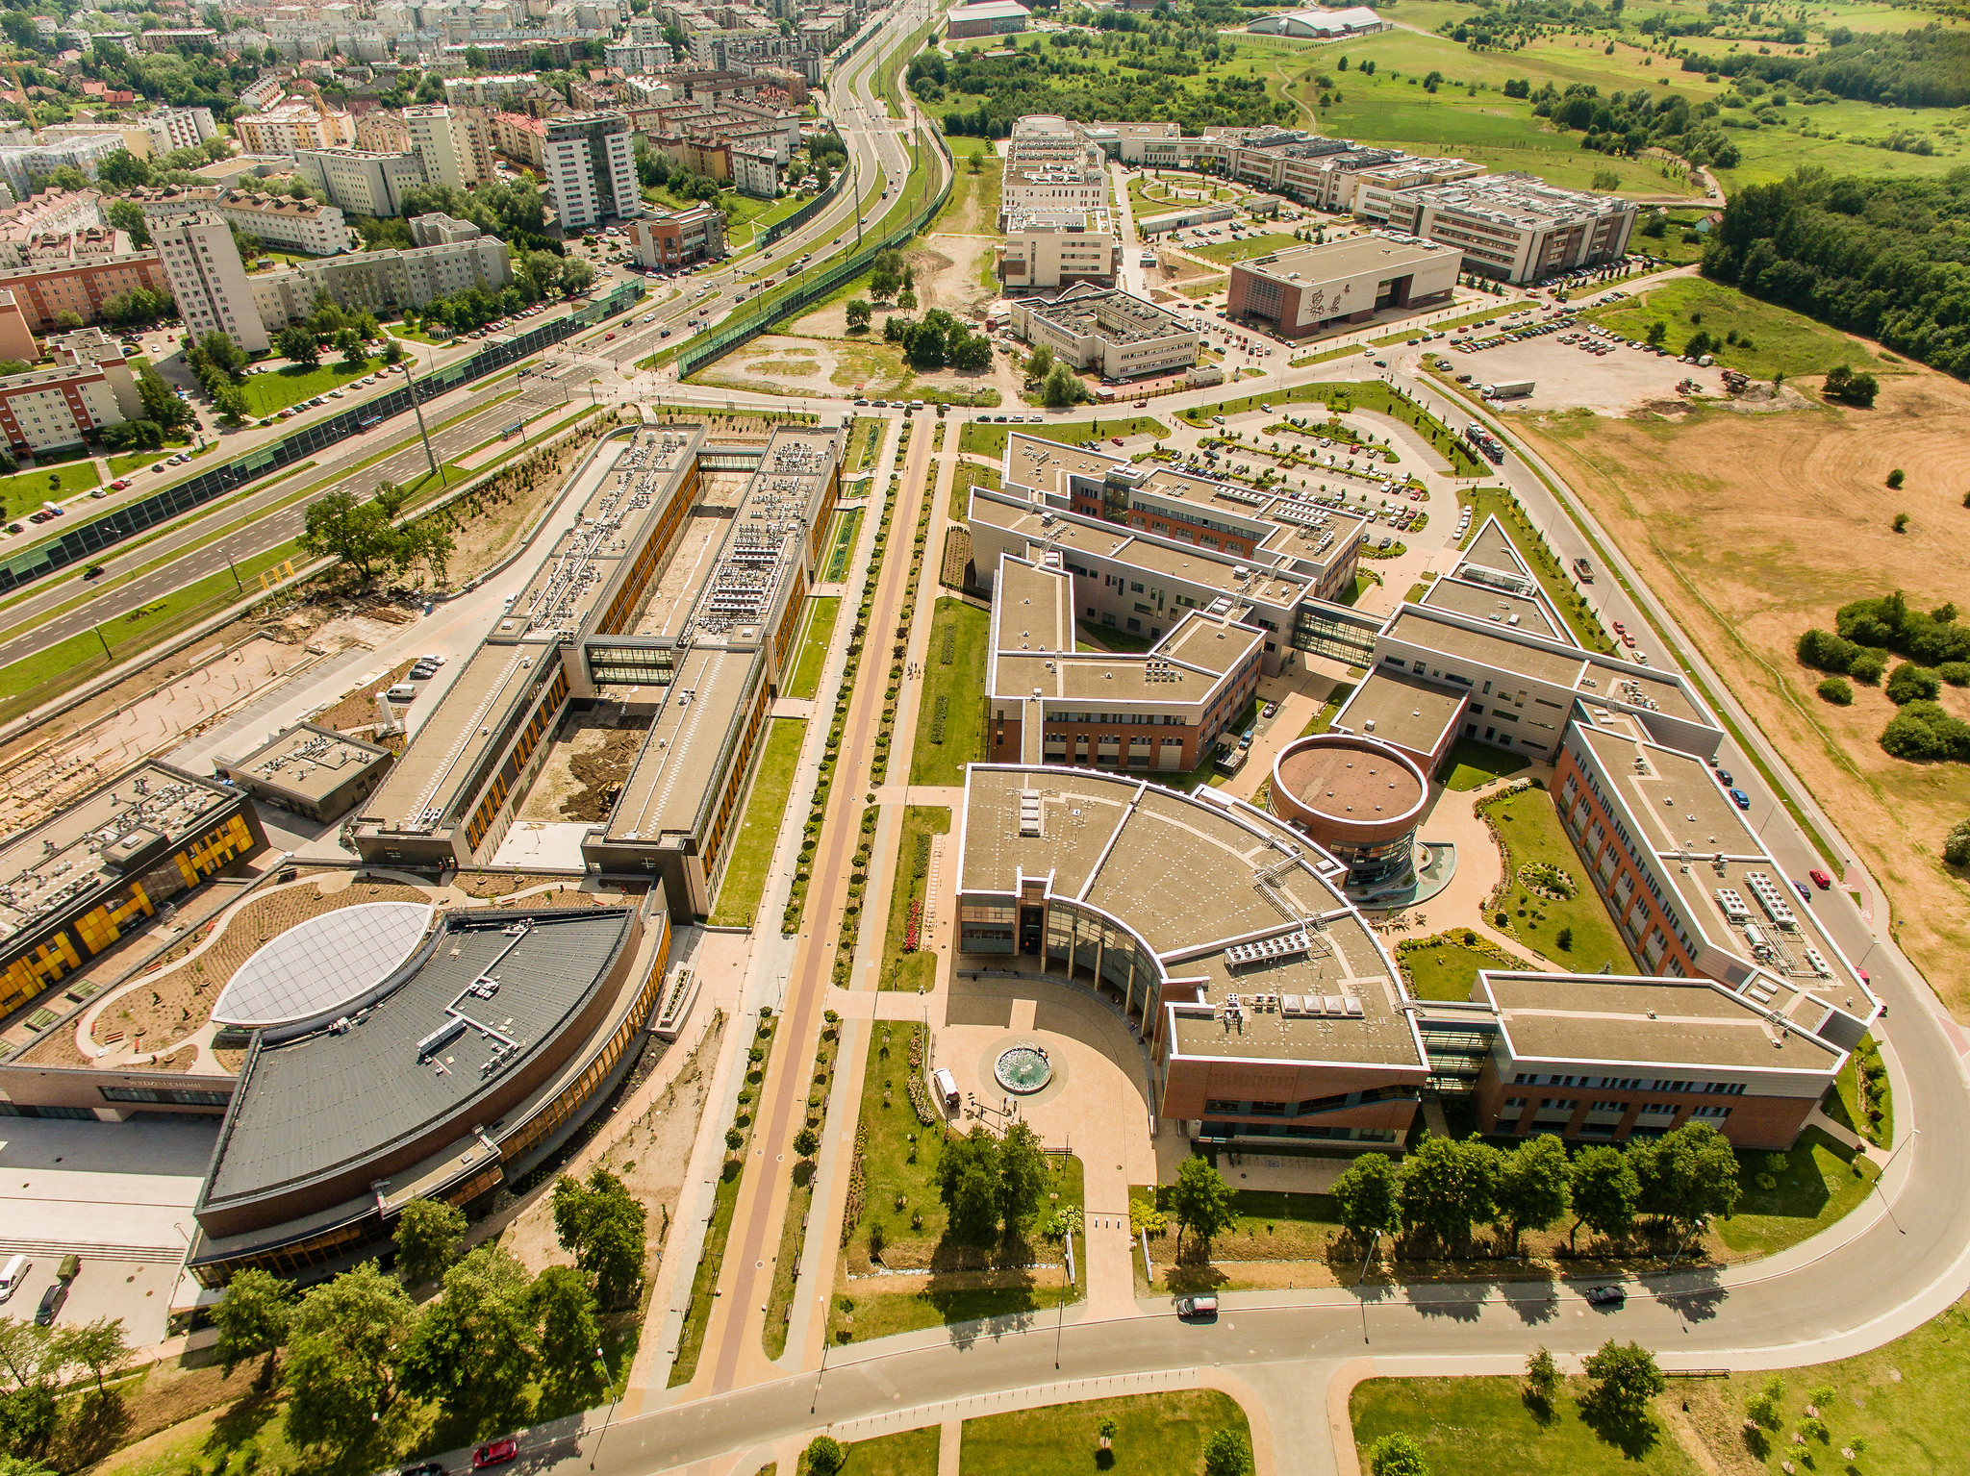
Plan
Introduction: Adopting consumer protection-by-information model to increase sustainability of consumer choices
Regulatory overview: what 2024 brought
Challenges of repurposing the protection-by-information model
  Choosing the moment at which information is provided
  New information asymmetry as an outcome
  Regulating the manner of providing information
  Finding appropriate sanctioning mechanism
Conclusions

Slide 3

Adopting consumer
protection-by-information model
to increase sustainability of consumer choices
Underlying assumptions:
The model of protection-by-information may be adopted to increase the sustainability of the common market
Consumers as EU citizens
Consumers could AND should become the drivers of the green transition
Obstacles: lack of information and misinformation

Slide 4
Regulatory overview
Design and production stage | Marketing stage | Usage stage
Ecodesign Directive | EU Ecolabel Regulation & Proposal of Green Claims Directive | Sale of Goods Directive
Art. 1(1) introducing ecodesign requirements for energy-related products | Art. 7-8 voluntary; requirements for environmental claims regarding products, organizations, and environmental labeling schemes | Art. 13(2a) introducing obligation to inform about choice between repair and replacement and „time bonus”
Ecodesign for Sustainable Products Regulation | Consumer Rights Directive & Directive on Empowering Consumers for the Green Transition | Right to Repair Directive
Art. 1(2); Art. 5; Art. 7 any physical good placed on the market; new types of requirements; Digital Product Passport | Art. 5(1)(e),(ea)-(ed), (i)-(j); Art. 6(1), (la)-(lc), (u)-(v) main characteristics of the goods or services; repairability score | Art. 1(1); Art. 4 European Repair Information Form

Slide 5

Challenges of repurposing the protection-by-information model: „preliminary” hurdles
Fuelling protection-by-information model
Framing requirements regarding the information on environmental costs in a way that allows it to effectively fuel the protection-by-information model throughout the lifecycle of the goods (understandable, reliable, and comparable vs precise and technically correct)
Back to the bitten tracks
The well-known flaws of the consumer protection-by-information model reappear.
Consumers as the driving force of green transition
There are three scenarios to be distinguished:
environmental and consumer interests align,
consumer interests can be pursued regardless of the environmental ones,
environmental and consumer interests collide.

Slide 6
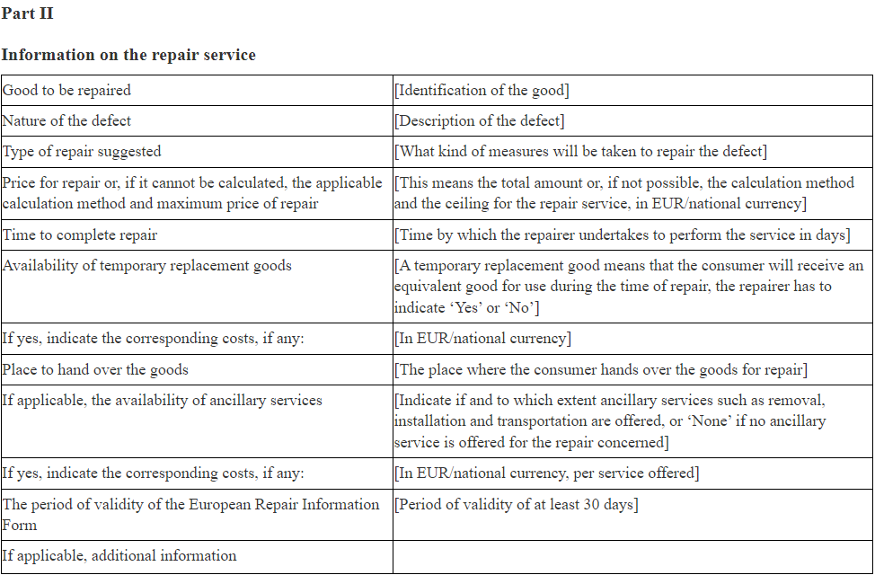
Challenges of repurposing the protection-by-information model: specific issues
Choosing the moment at which information is provided
New information asymmetry as an outcome: lacking information obligations on the environmental costs
Regulating the manner of providing information

Slide 7
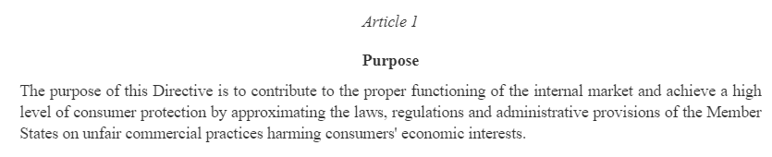
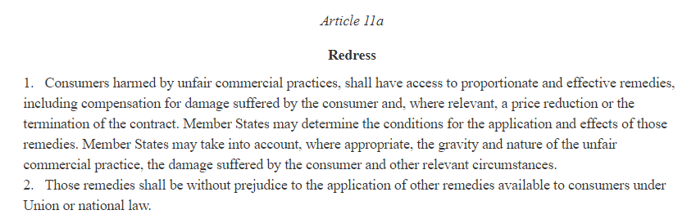
Challenges of repurposing the protection-by-information model: specific issues
Mismatched sanctioning mechanism
Right to compensation
Termination
Price reduction
Other measures under national law
Art. 12(1) point 3 of Polish unfair market practices act [ustawa o nieuczciwych praktykach rynkowych]: consumers may demand that the person who committed an unfair commercial practice against them submits a statement of particular content in a chosen form, which is typically done by publishing such a statement in the media.
Art. 12(1) point 5 Polish unfair market practices act: consumers may demand that the trader pays a sum of money for a specific social purpose related to supporting Polish culture, national heritage, or consumer protection.

Slide 8

Conclusions
Inoperable law of clay tablets
the number of sources from which information obligations arise and the detailed nature of that information makes it impossible for consumers to make greener choices
Further differentiation imminent
different addressees of norms require different information (content/form/granularity) at different points in time
Always have in mind environmental costs
the environmental impact of rules should never be disregarded: otherwise, the cure may be worse than the disease (UCPD case)

Slide 9

Thank you
for your attention
katarzyna.poludniak@uj.edu.pl
This presentation was prepared within the project „Homo consumens, Homo ecologicus – ecological efficiency test of the new directive on certain aspects concerning contracts for the sale of goods” financed by Narodowe Centrum Nauki, (NCN) [National Science Centre] in Kraków, Poland, with the number of 2019/34/A/HS5/00124.

