Slide 1
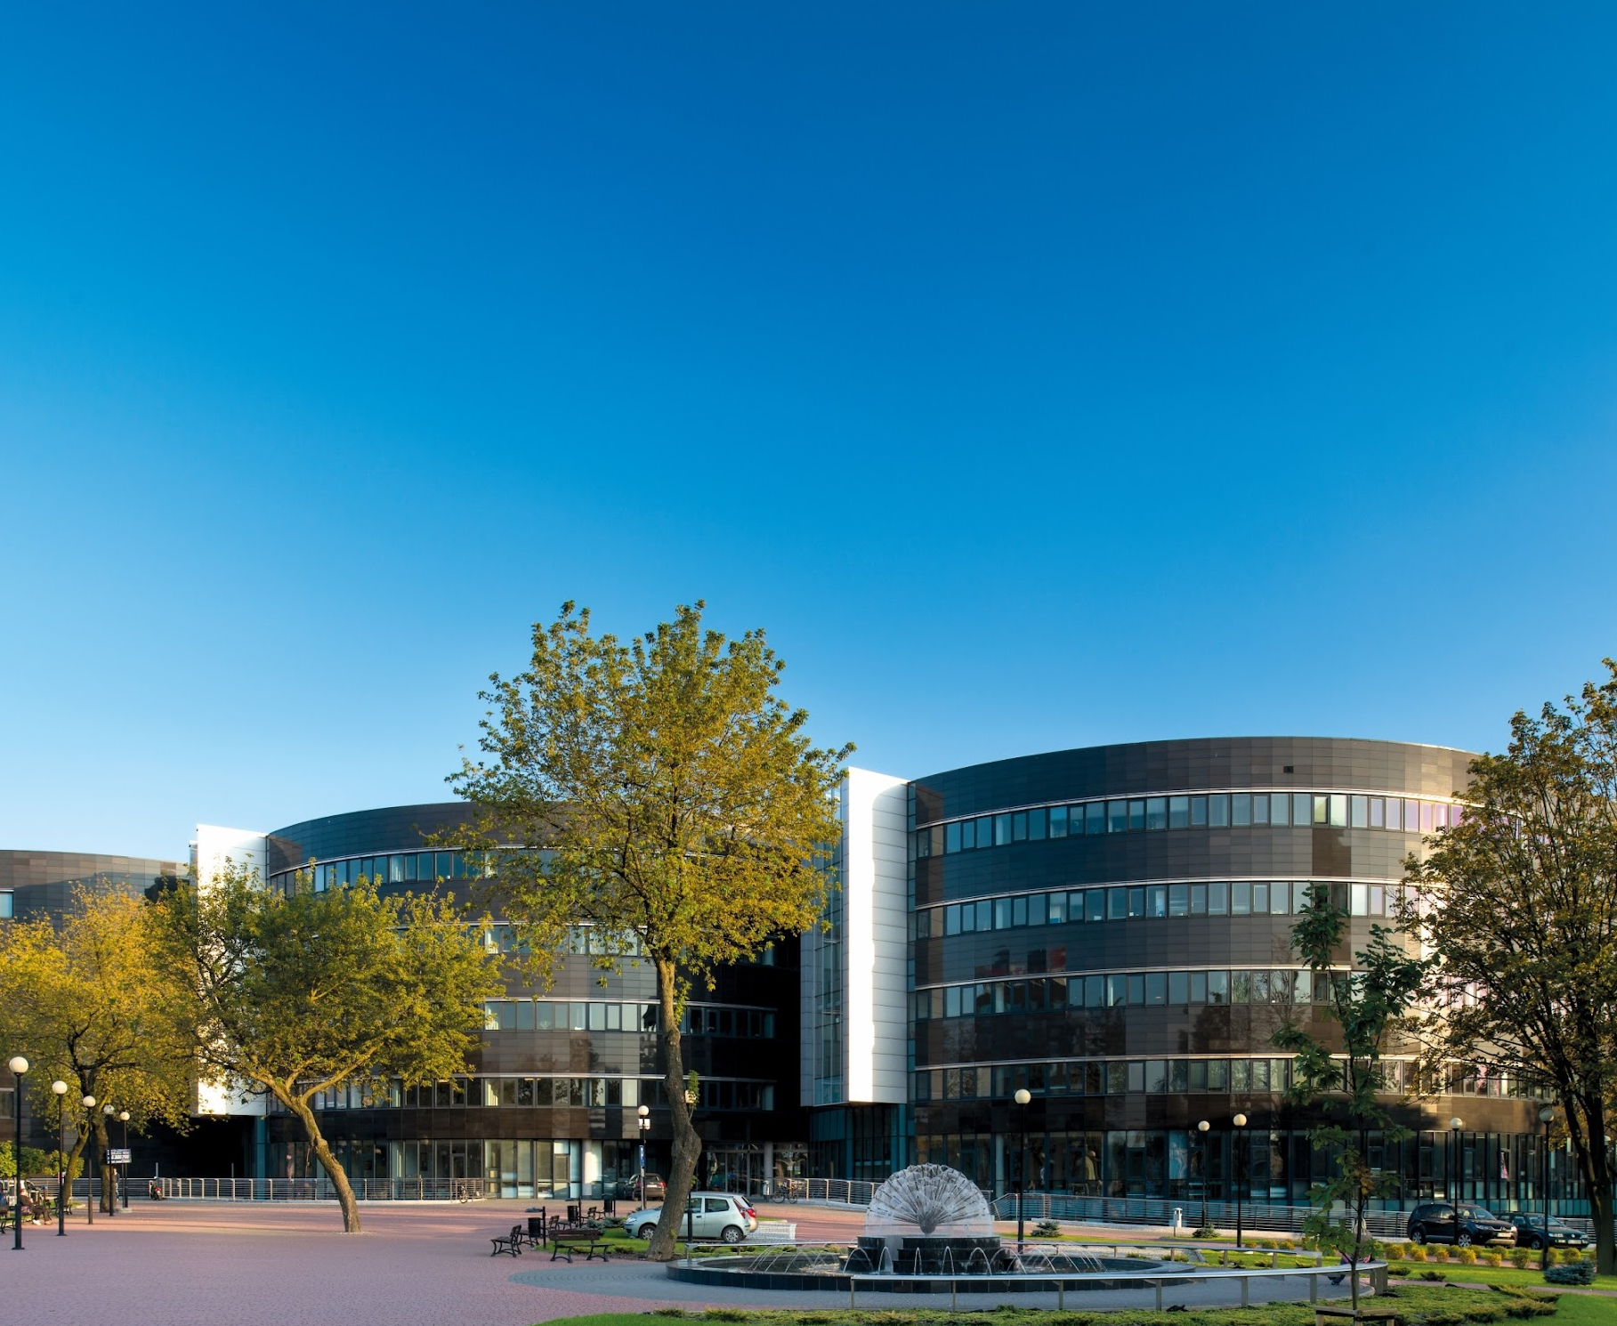



1st European Conference of the International Association of Consumer Law
Girton College, Cambridge
17-18.9.2024
Professor Dr. Monika Namysłowska
Magdalena El-Hagin, Judge, Ph.D. candidate
Reflections on Two Decades:
Polish Consumer Law and Digital Transformation
Notes:
<numer>

Slide 2

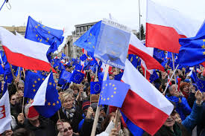
I. Stepping into the Spotlight
Since 1st May 2004
1st May 2004
Created by ChatGPT 4o
11
Notes:
<numer>

Slide 3




II. A Dance of Two Decades
2004: Skype was created
4 February 2004: Facebook was established
17 February 2004: Google's index exceeded 6 billion elements
9 November: the Mozilla Firefox browser was created
11
Notes:
<numer>

Slide 4


II. A Dance of Two Decades
Created by ChatGPT Plus
11
Notes:
<numer>

Slide 5
II. A Dance of Two Decades
Contents:
1) The implementation process
2) Addressing regulatory gaps
3) Possible inspiration from Poland for EU law

Slide 6
III. Learning the EU Dance
e-Commerce Directive (2000/31/EC)
Directive 2005/29 on unfair business-to-consumer commercial practices
Directive 2020/1828 on representative actions
11
Notes:
<numer>

Slide 7
IV. Polish Moves in the EU Consumer Law Dance
The UCPD
  Reversed burden of proof
Activities of the UOKiK
  Recommendations on the labelling of advertising content by influencers on social media
  Project ’Detecting and combating dark patterns using Artificial Intelligence’
11
Notes:
<numer>

Slide 8

V. Dancing into the Digital Future
The DSA and AIA
Courts are overwhelmed
Stronger enforcement mechanisms
Digital literacy
Created by ChatGPT Plus
11
Notes:
<numer>

Slide 9

Thank you for your attention!
mnamyslowska@uni.lodz.pl
LinkedIn: Monika Namysłowska
Magdalena.el-hagin@iustitia.pl
LinkedIn: Magdalena El-Hagin
Notes:
<numer>

