Slide 1
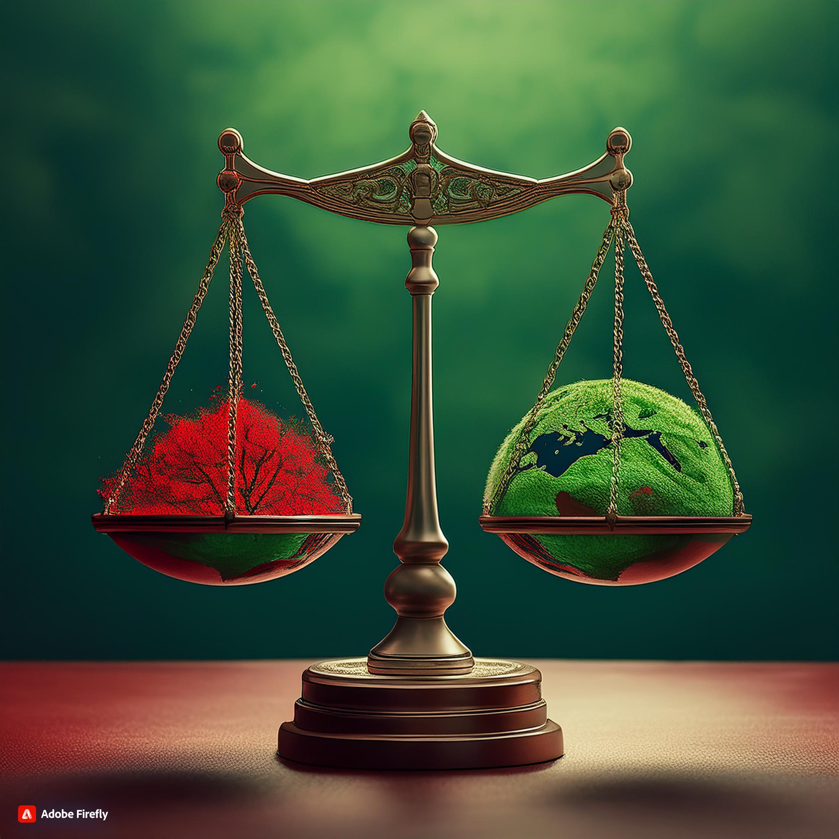
The Boundaries of Greenwashing
- Are your Consumer Rights Best Served by Greenwashing or Greenhushing?
By Marianne Hundahl
Assistant Professor
Aalborg University, Denmark
Hundahl@law.aau.dk

Slide 2

Background
#’green marketing’
→ Greenwashing
→ Greenhushing
→Greenwishing

Slide 3

The Danish Crown case
Background
  Use of the statements
    “Climate-controlled pig”
Result
  Violation of Section 5 of the Danish Marketing Practices Act because no proper control in place
  (UCPD article 5(1), (3) and (4) and article 6)

Slide 4
The Danish Crown case
Statement
    “Danish pig is more climate friendly thank you think”
Result
    Not misleading

Slide 5

Discussion
“Danish pig is more climate friendly thank you think”
→ Must be understood relatively and not absolutely
Jan Trzaskowski: “Danish pig is less harmful to the climate than you think”
How different words affect consumers expectations and trust
Positive/lesser negative environmental impacts?

Slide 6
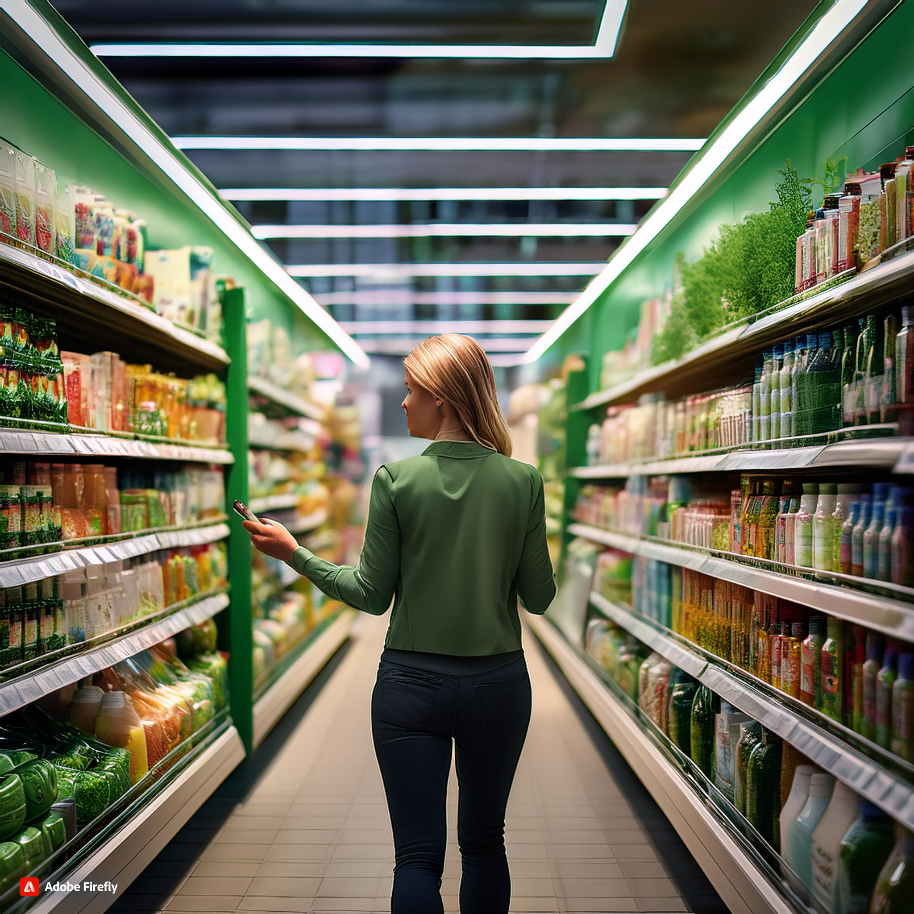
The Consumer’s Rights
Remedies for breach of contract?
From a Danish perspective:
  The Danish doctrine of presuppositions? (maybe close to ‘clausula rebus sic stantibus’)
  Greenwashing as a defect in the product?

Slide 7
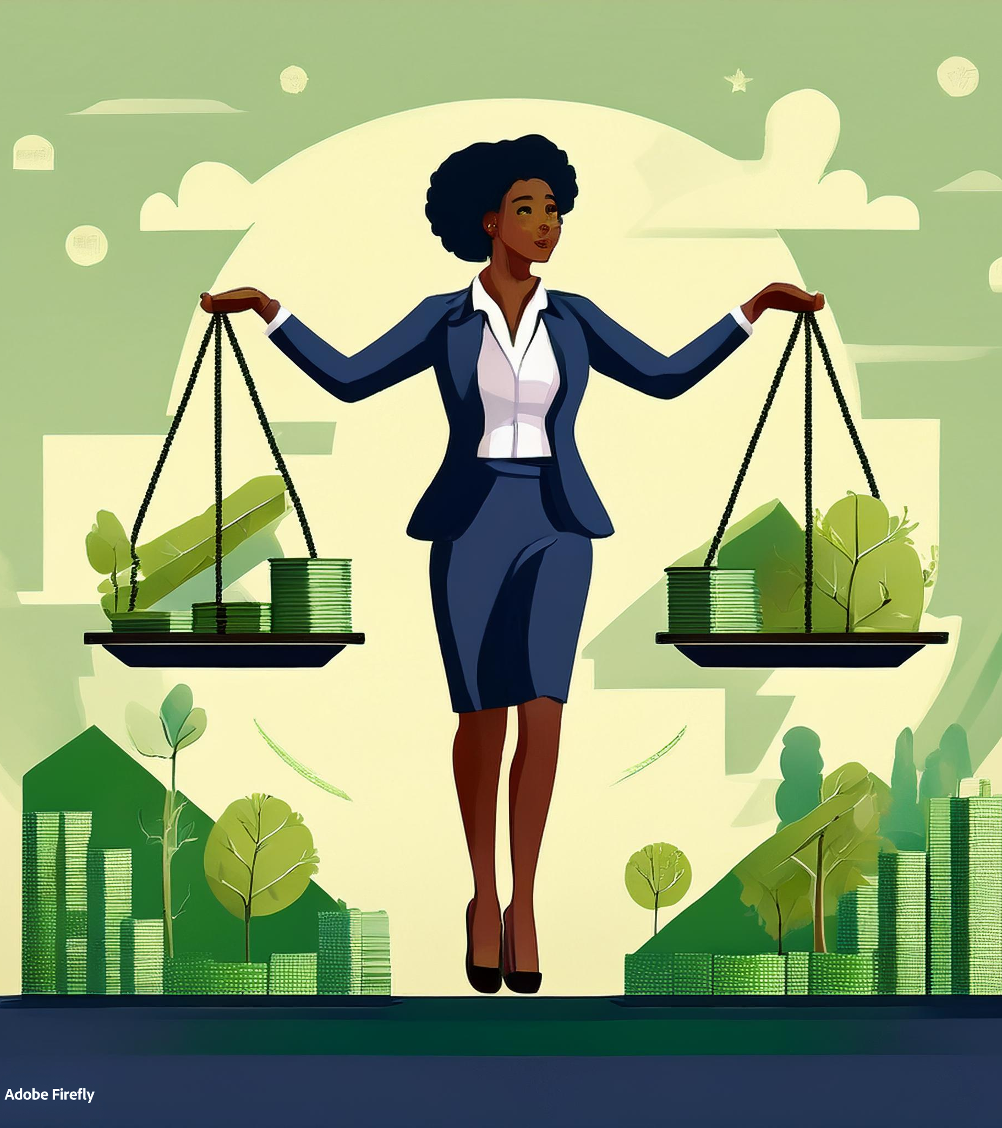
The future
Green Claims Directive
Should all environmental claims be verified by a third party?
  + Increased credibility, consumer protection, competitive advantage
  ÷ Increased costs, bureaucracy, greenhushing
Should a product be required to include (detailed) instructions on how to reduce environmental impact?
  + Consumer guidance, increased awareness, long-term benefits
  ÷ Complexity, practical challenge, costs

Slide 8
Final remarks
Will the Green Claims Directive fix everything?
Should greenwashing itself allow the consumer to exercise e.g., the remedies for breach of contract?
Are your consumer rights best served by greenwashing or greenhushing?

