Slide 1
The role and responsibility of online marketplaces in EU law
Martien Schaub
17 September 2024

Slide 2
Online
Marketplace
Supplier
Consumer

Slide 3




Slide 4
Consumer law authors about online marketplaces
“substantial confusion about the legal position of the platform operators in different fields of law”
“legal framework is uncertain, particularly with regard to the question whether they are intermediaries for the purpose of specific intermediary liability regime”
“no broad academic or political debate on an extension of product liability law to online marketplaces”

Slide 5
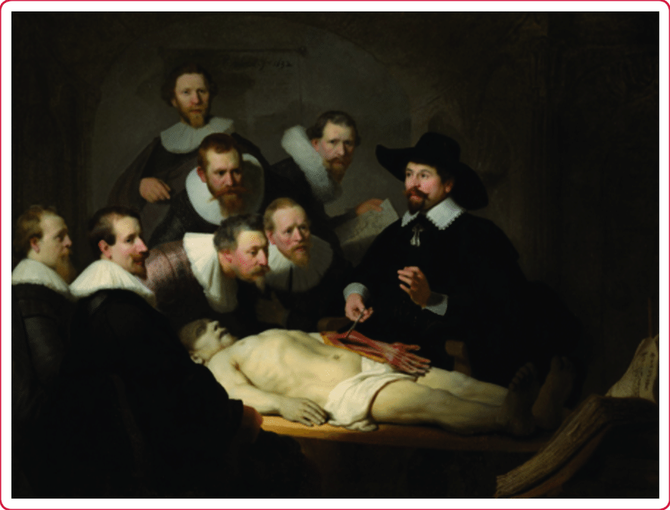
Us
Law

Slide 6

Which laws?
Directive (EU) 2019/2161 (Modernization directive)
Regulation (EU) 2022/2065 (Digital Services Act)
New Directive on product liability
-> Responsibility of online marketplaces

Slide 7
Directive (EU) 2019/2161 (Modernization directive)
Information requirements for online marketplaces:
(a) general information on the main parameters determining ranking;
(b) whether the third-party supplier is a trader or not, based on the declaration of that third party to the provider of the online marketplace;
(c) where the third-party supplier is not a trader, that the consumer rights do not apply to the contract;
(d) how the obligations related to the contract are shared between the third-party supplier and the online marketplace.

Slide 8
Directive (EU) 2019/2161 (Modernization directive)
such information being without prejudice to any responsibility that the provider of the online marketplace or the third-party trader has in relation to the contract under other Union or national law.
-> What is the responsibility of online marketplaces under EU or national law?
-> What remedy do consumers have?

Slide 9
Consumer law authors on the Modernization directive:
Much more can be done to approach regulation of the important roles and functions of online marketplaces.
The lack of substantive rules dealing with online marketplaces may be regretted.

Slide 10
Regulation (EU) 2022/2065 (DSA)
Know Your Business Customer (art. 30)
Compliance by design (art. 31)
Right to information (art. 32)
Exemption from liability for illegal information of third-party suppliers (art. 6)

Slide 11
Article 30 DSA – KYBC or traceability
Collect and check information of suppliers, amongst others:
the name, address, telephone number and email address.
Store the information for a period of six months after the end of the contractual relationship with the trader concerned. They shall subsequently delete the information.
-> What remedy do consumers have?

Slide 12
Article 31 DSA – Compliance by design
+ article 22 (9) Regulation (EU) 2023/988 (general product safety)
Design the online interface in a way that enables the suppliers to comply with their obligations regarding pre-contractual information, compliance and product safety information under applicable Union law.

Slide 13
Article 31 (3) DSA
Make best efforts to assess whether suppliers have provided the information prior to allowing them to offer their products or services.
Make reasonable efforts to randomly check whether the products or services offered have been identified as illegal.
-> What remedy for consumers?

Slide 14
Article 32 DSA – Right to information
When an online marketplace becomes aware that an illegal product or service has been offered the online marketplace shall inform, insofar as it has their contact details, consumers who purchased the illegal product or service through its services of the following:
(a) the fact that the product or service is illegal;
(b) the identity of the trader; and
(c) any relevant means of redress.
-> Any remedies for consumers?
And that’s it?

Slide 15
Article 6 DSA - Exemption from liability
Hosts are exempted from liability for illegal activities by third parties:
  no actual knowledge, and
  act promptly when such knowledge is obtained.
Exemption from the exemption:
An average consumer would believe that the information, or the product or service that is the object of the transaction, is provided
-> either by the online platform itself, or
-> by a supplier who is acting under its authority or control.

Slide 16


E-commerce Directive
Digital Services Act

Slide 17
Consumer law authors on the DSA
From a consumer law perspective, it could have been more ambitious.
Would have been preferable if the private law consequences had been addressed by the DSA.
The DSA appears to be more concerned with providing legal protection and certainty to intermediary service providers than to consumers using their services.

Slide 18
New Product liability directive
Manufacturer and manufacturer of component
Importer
Authorized representative of the manufacturer
Fulfilment service provider
Distributor
Online marketplace:
  fails to identify another economic operator in the EU or its own distributor, AND
  average consumer is lead to believe that the online platform is the supplier or that the third-party supplier is acting under authority or control of the online platform.

Slide 19

Will an online marketplace be liable under the new Product liability directive?

Slide 20


Slide 21
Consumer law authors on the new Product liability directive
The Directive is a wonderful legal topic, raising many fascinating issues, but it is a very disappointing instrument when it comes to achieving a truly common market and enhancing consumer protection.

Slide 22

Consumer law authors:

Slide 23
Seen the role of an online marketplace in facilitating consumer transactions with third-party suppliers:
Should the online marketplace have more responsibility?

Slide 24
The end
Martien Schaub
Schaub@law.eur.nl

