Slide 1
Unveiling a New Era: Unfair Contractual Terms Assessment in Personal Data-as Counter-Performance Contracts
Assoc. Prof. Dr. Nafiye Yücedağ & Asst. Prof. Dr. Elif Beyza Akkanat-Öztürk
1st European Conference of the International Association of
Consumer Law

Slide 2
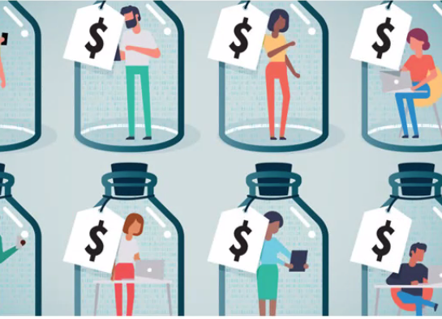
Presentation Outline:
Overview of the focus on content and transparency control:
  Article 4/2 of the Unfair Contract Terms Directive
    GDPR-Recitals para. 42
  Explanation of its meaning and scope.
    Transparency control: suitable mechanism for data-as-currency contracts (?)
Implications for Contracts Involving Personal Data
  Analysis of how this provision affects data-as-currency contracts.
  Discussion on Pay and Consent Models
Conclusion:
  Summary of key points and insights

Slide 3


Digital Products
(contents and services)
Digital Content or Services
Digital products
(Personal) Data as currency contracts

Slide 4
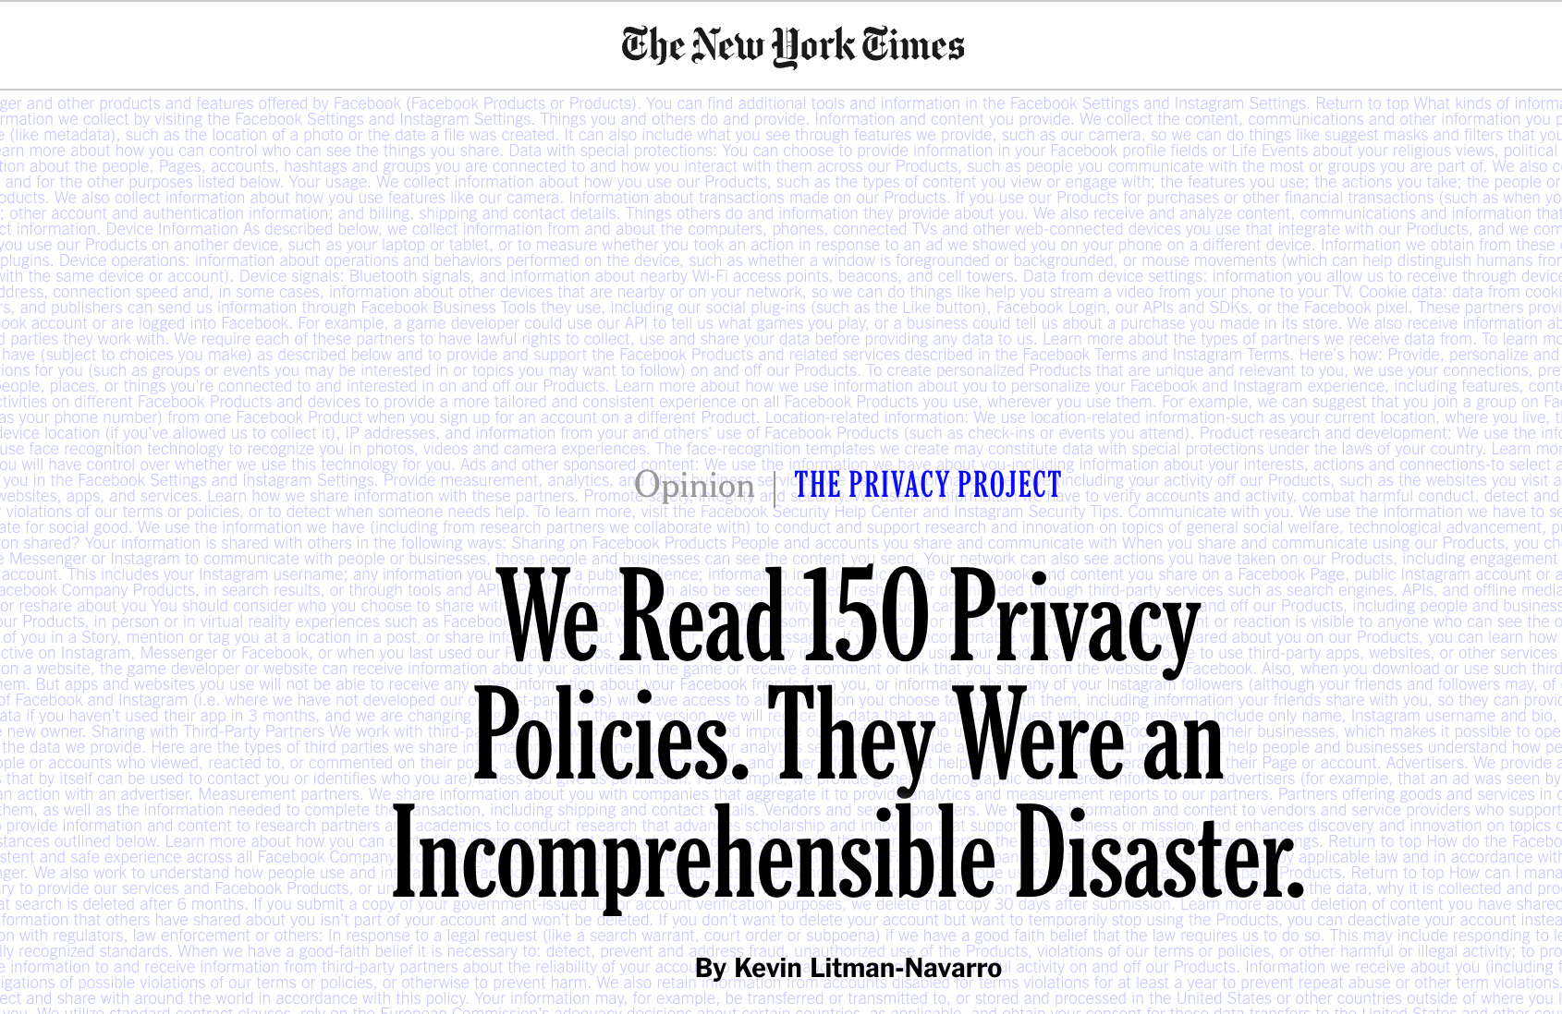
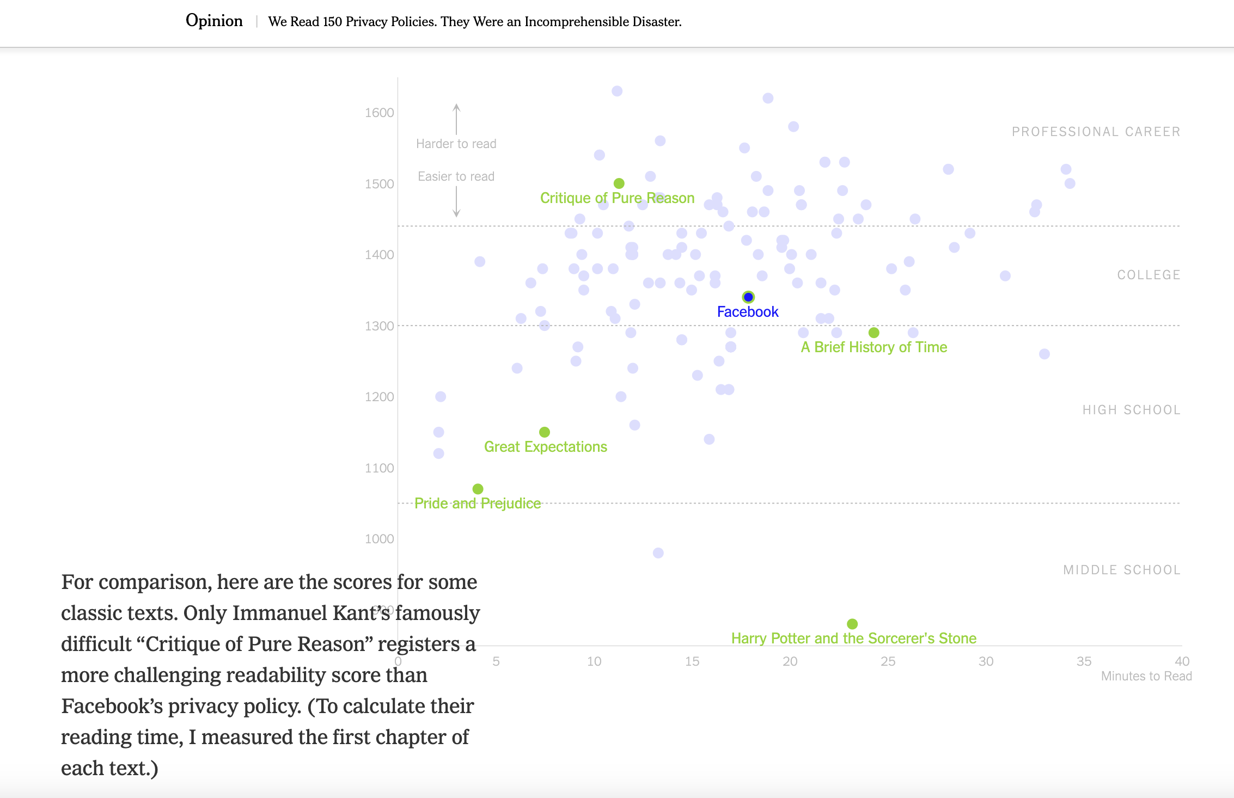

Slide 5

Unfair Contractual Terms Directive Art. 4/2:
Assessment of the unfair nature of the terms shall relate neither to the definition of the main subject matter of the contract nor to the adequacy of the price and remuneration, on the one hand, as against the services or goods supplies in exchange, on the other, in so far as these terms are in plain intelligible language.»

Slide 6

Ensuring Transparency in Consent Terms:
FIRST ISSUE: Validity
Affect of Data Protection Rules
SECOND ISSUE: The Concept of Informed Consent and Privacy Policies
«Informed Concent Concept»
GDPR Art 4/11, Art 5/1/b

Slide 7

SO: The transparency test assesses if consent elements are present in a legal relationship, using criteria of clarity and comprehensibility.
Berlin Regional Court
(LG Berlin (Zivilkammer 16), Urteil vom 16.01.2018-16 O 341/15, BeckRS 2018 N 56-57)
The Austrian Supreme Court of Appeal (Oberste Gerichtshof)
(Oberster Gerichtshof, 31.08.2018, 6 Ob 140/18h, N. 1.4 et al)
IS Term “Free” misleading (?)

Slide 8

Price Control (?)
Value of Personal Data
  Narrow Interpretation (?)
  GDPR Art. 5
    Data Minimisation Principle
      Excessive Data Collection
    Purpose Limitation Principle

Slide 9

Pay or OK Models
(new era for digital enviroment)
Freely Given Consent
  Cookie walls vs. Pay walls
  Paid Alternative
    Reasonable Price
  Price and remuneration control beyond transparency (?)

Slide 10
Concluding Remarks
This presentation explores the application of the unfairness test to contracts involving the exchange of personal data.
It explains how transparency and content control are specifically applied in these relationships.
Transparency in data exchange contracts allows for intervention in the content and scope of obligations.
However, new discussions and challenges in this area continue to emerge
PAY OR OK models

Slide 11

Nafiye Yücedağ
Elif Beyza Akkanat-Öztürk

