Slide 1

Redefining the Function of Consumer Insolvency Law:
A Theoretical Basis for a Balanced System
Rahaf Al Shneikat
17Th Sept 2024
Notes:
Good Morning Everyone! My name is Rahaf Al Shneikat and I am a PhD Candidate at the University of Manchester. My presentation today is on …….
In this area of research, the work of Prof Ramsay has enriched our understanding of this area of research and developed the conceptual role of consumer credit and indebtedness in modern society. Most importantly, for PhD candidates such as myself, his work is a vital stepping stone for any research topic on consumer insolvency. I am deeply honoured to be on this panel for works celebrating the contribution of Prof Ramsay. My proposal for today takes inspiration and builds on this work and I look forward to your feedback.

Slide 2
Credit, Debt & Income Inequality
Distributive Justice and Consumer Credit
  Credit assumed a role to supplement and support the basic needs of Individuals due to drop in income levels; Iain Ramsay, Consumer Credit Law, Distributive Justice and the Welfare State (1995), Susanne Soederberg, Debtfare states and the poverty Industry: money, discipline and the surplus population (2014).
Debt and Income Inequality
  Debt increases the pressure on income repayment capacities deepening the impact of income inequality; Raghuram Rajan, Fault Lines: How Hidden Fractures Still Threaten the World Economy (2010), Jodie Gardner J, Mia Gray and Katharina Möser (eds), Debt and Austerity: Implications of The Financial Crisis (2020).
Notes:
I begin first with a point you are mostly familiar with: the increasing reliance on consumer credit in an economy of welfare retrenchment and income stagnation.
In the political economy discourse, there is an acknowledgement of the redistributive role of credit (in the general sense, secured and unsecured credit) to supplement and support the drop in income levels and enable consumers to participate in the economy. Credit enables those households suffering from limited financial capacities due to drop in income levels to participate in the economy.
For example, In the United Kingdom, and before the Financial Crisis use of housing for consumption purposes has been easily accessible via what is known as Home Equity Withdrawal using a study based on household panel survey.
Several names has been given to this trend, call it ‘credit/welfare trade off’/ privatized Keynesianism or financialisation of economy 🡪 The common ground is the centrality of credit in facilitating a socio-economic wellbeing to consumers.
So, on the one hand, access to credit is no longer a sign of affluence but rather a sign of need due to an increase in income inequality levels promoted by privatisation and the rise in capital income.
On the flip side, debt exacerbates income inequality. While, credit affords a breath of fresh air in times when incomes are tight, it eventually leads to exposing the consumer to added expenses leading to a squeeze on their budgets and what is known as poverty-induced debt.

Slide 3
The Distributional Effect Of Indebtedness
An Expansion of Debtor Demographics:
  Bankruptcy as a middle-income group phenomenon; Teresa A. Sullivan, Elizabeth Warren, Jay Lawrence Westbrook, As we Forgive our Debtors: Bankruptcy and Consumer Credit in America (1989).
  The recognition of No Income No Assets debtor (NINA)and Low-Income Low Assets debtor (LILA); World Bank, Report on the Treatment of the Insolvency of Natural Persons (2014).
  The Debt Poor and the Squeeze on the Middle-Income Group: Recent increases in housing costs coupled with an increase in the cost of living and global inflationary trend have resulted in middle-income groups being squeezed between insufficient income levels and increasing debt repayment requirements impacting their socioeconomic mobility; Robert H. Scott and Steven Pressman, A Double Squeeze on the Middle Class (2011).
The Department for Work & Pensions (DWP) publishes a yearly series called (Household Below Average Income HBAI) calculating income distribution before and after housing costs, which are defined as follows:
  rent (gross of housing benefit);
  water rates, community water charges and council water charges;
  mortgage interest payments;
  structural insurance premiums (for owner occupiers); and
  ground rent and service charges.
DWP, ‘Households Below Average Income series: quality and methodology information report FYE 2023’ (2024).
Notes:
These developments have led to a shift in the impact of Overindebtedness.
As we forgive our debtors told us that it is a middle-income, and at the same time debtors with none or few assets NINA/LILA
However, the recent increase in housing costs coupled with cost of living crisis and global inflationary trends has led to a group of debtors known as the debt poor –( those who on paper are affluent but in fact are struggling).
The UK provides a better understanding.

Slide 4
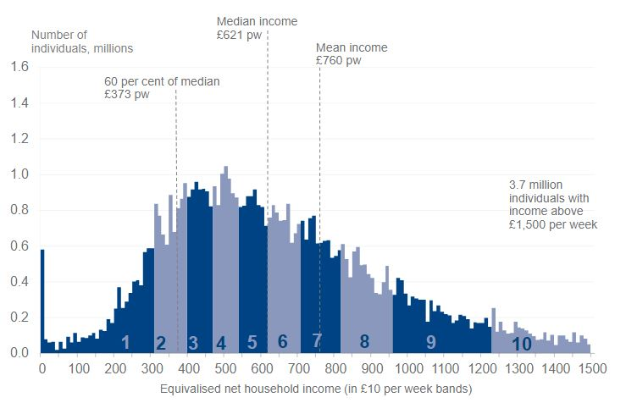
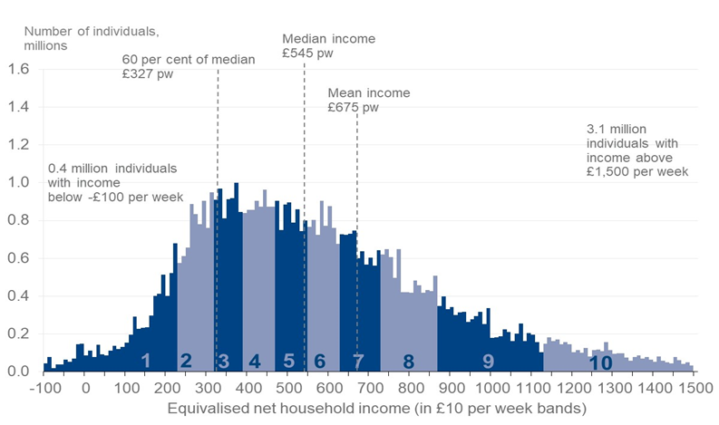
Income distribution for total population, Before Housing Costs (BHC), FYE 2023.
Source: DWP, ‘Households Below Average Income: An Analysis of the UK Income Distribution FYE 1995 to FYE 2023’ (HBAI Data Tables, Table 2.1 BHC), 2024.
Income Distribution for total population, After Housing Costs (AHC), FYE 2023.
Note from the HBAI: Negative incomes BHC are reset to zero, but negative AHC incomes calculated from the adjusted [equivalized] BHC incomes are possible. Where incomes have been adjusted to zero BHC, income AHC is derived from the adjusted [equivalized] BHC income.
Source: DWP, ‘Households Below Average Income: An Analysis of the UK Income Distribution FYE 1995 to FYE 2023’ (HBAI Data Tables, Table 2.1 AHC), 2024.
Notes:
Income levels are calculated on a weekly basis. As you can see, in the two graphs there is a slight difference in population numbers according to their income levels. To ease things a bit

Slide 5

HBAI Income Distribution and Population Levels
Weekly Income Level | Yearly Income Level | Decile Distribution BHC | Population Number BHC | Decile Distribution AHC | Population Number AHC
£420-£460pw | £20,160-£22,080 | 3 | 4,528,937m | 4 | 4,485,264m
£480-£520pw | £23,040-£24,960 | 4 | 4,756,065m | 5 | 4,176,789m
£560-£610pw | £26,880-£29,280 | 5 | 5,037,706m | 6 | 4,029,084m
£630-£700pw | £30,240-£33,600 | 6 | 5,206,180m | 7 | 4,794,392m
* Income Distribution for Deciles 1&2 reflects poverty statistics in the UK described as ‘relative low-income’. According to the HBAI 2023, 17% of the population falls in relative low income BHC, and this percentage increases to 21% AHC.
Source: DWP, ‘Households Below Average Income: An Analysis of the UK Income Distribution FYE 1995 to FYE 2023’ (HBAI Data Tables, Table 2.1 AHC) 2024.
Notes:
I created this table based on data published on the DWP HABI series. As you can, income levels before and after housing costs fall within different distributional deciles and at the same time the population numbers also differ. While, for each income levels the population AHC is slightly lower from that of BHC this indicates that while population numbers moves up on the income distribution, it indicates that each decile compromises a lower income level and that those populations who do not make the high decile distribution are relegated to lower ones supporting the assumption of a squeeze and debt poor. That being said, this does not present the entirety of the impact of debt on income distribution.

Slide 6

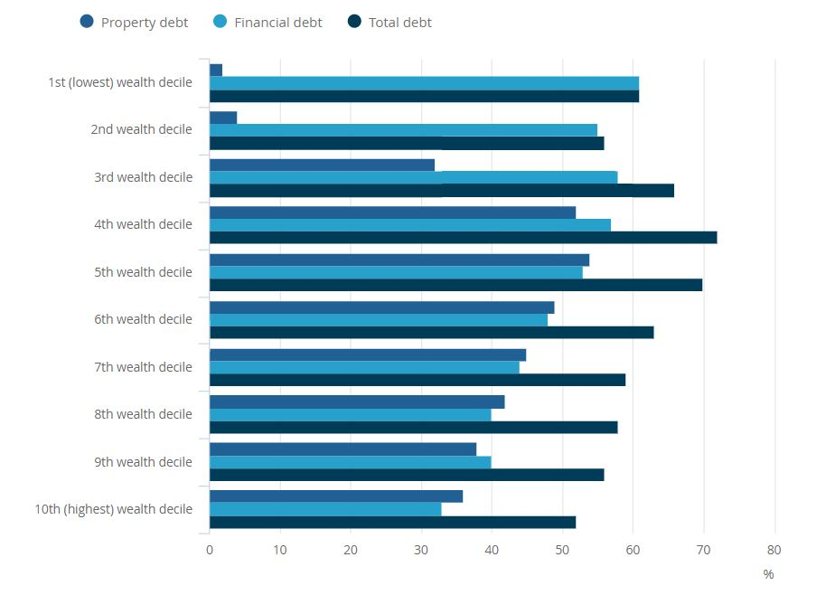
The previous account on the distributional effect of indebtedness while covering housing costs does not include the following debt repayment requirements:
Student Debt
Consumer Credit
Priority Debt (council tax, energy bills and other government debt).
Source: Office for National Statistics, ‘Household debt in Great Britain: April 2016 to March 2018’ (2019).
Notes:
The graph is taken from the Office of National statistics explaining the distribution of debt with the added benefit of including (consumer credit and student debt) as financial debt.

Slide 7
Over-indebtedness and Distribution
Triggering over-indebtedness leads to deepening the distributional impact of debt:
  The state of being insolvent is a socioeconomic event giving rise to debt-induced poverty, a slow decline in middle-income levels and entrenching income inequalities; Matthew P. Drennan, Income Inequality: why it matters and why most economists didn’t notice (2015).
  Over-indebtedness threatens the well-being and welfare of the individuals themselves and in return, the society in general and eventually reflects on the ability of these consumers to participate in the economy; Branko Milanovic, Global Inequality: A New Approach for the Age of Globalization (2016).
  In specific, debt is slowly eroding the financial capacities of the middle-income groups (with a high propensity to consume) exacerbating economic inequalities and thereby exposing the financial well-being of the economic system to macroeconomic shocks; Joseph Stiglitz, the Stiglitz Report (2010), Atif Mian and Amir Sufi, House of Debt (2014), Joseph Spooner, Bankruptcy: The Case for Relief in an Economy of Debt (2019).
Notes:
The point is we conclude from this discussion is that in a debt-dependence economy where economic and social inequalities have been on the rise, the state of being in debt has been normalized for certain groups on the income distribution.
Read the slides [explains the distributional effects]
Access for debt while it demands considerations of responsible lending, is born out of a need to manage the demand of lives who has become increasingly difficult with the capacity for social mobility limited.

Slide 8
Debt Relief and The Social Insurance
The ‘Fresh Start’ and Debt Relief as a Social Insurance
  Discharge and the ‘fresh start’ is a risk allocation means whereby discharge transfers the risk to the superior bearer of risk is capable of anticipating the costs and taking measures towards it; Thomas H. Jackson, The Fresh-Start Policy in Bankruptcy Law (1985), Iain Ramsay, Models of Consumer Bankruptcy: Implications for Research and Policy (1997) and Spooner, Bankruptcy: The Case for Relief.
There is a need for a just and equitable approach for the ‘fresh start and the debt relief function.
Distributive Justice or Allocative Justice? Ezra Mishan, The Futility of Pareto-Efficient Distributions (1972)
  The legal theory on social insurance and welfare economics.
Notes:
Legal Theory on the fresh start has associated the role of debt relief laws as part of welfare laws performing a function of social insurance. Emphasising that it is a safety net of last resort
Professor Jackson and Prof Howard advanced the theory of risk in discharge with the assumption that debtors are the superior risk bearers and they are the ones who are expected to bear the costs of default.
Recently. Dr Spooner argues that in a framework of risk allocation as such bankruptcy, creditor is the risk bearer who is able to account for the costs of default and the consequent discharge in an economy of debt.
While, I agree with these theoretical approaches as a premise of having debt relief laws as a safety net of last resort, these assumptions do not consider concerns of income inequality or distributive justice in their framework of fresh Strat and if they do they fall second and third to requirements of risk allocation or what it is termed allocative justice.
Unfortunately, assumptions of distributive justice are mostly linked to income transfers or income maintenance. My proposal does not propose a framework of income transfer nor does the fresh start and debt relief should perform this task.
Most importantly, social insurance is not a mechanism of income theory (while it may have allowed it) social insurance performs on the assumption of a probability or chance and universal social insurance systems seen post-war and the criticism it received have led to the development of what is subjective probability. So by linking the theories of social insurance and that of efficiency we are led to the conclusion that such a framework does not meet the demand of the distributional impact of debt which requires a balanced approach.

Slide 9
A Balanced Approach: Rawls and The Theory Of Justice
Rawls is not widely discussed in conceptual frameworks and legal theory of consumer insolvency
  Use of Rawls’ theory of Justice is more prominent in consideration of corporate insolvency; e.g. Donald R. Korobkin, Rehabilitating Values: A Jurisprudence of Bankruptcy (1991), Mary Josesphine Newborn, The New Rawlsian Theory of Bankruptcy Ethics (1994), David Millman, Promoting Distributional Justice on Corporate Insolvency in the 21st Century (2011).
The aim is to establish a holistic and systemic approach to debt relief in a Rawlsian Framework of Justice
  The Two Principles of Justice, social insurance and the debate on debt relief (zero-sum game)
  An analysis of the laws of England and Wales but with a general proposal for consideration on the principles of ‘fresh start’ in current socio-economic pressures.
Notes:
Questions such as; do we remove entry requirements of means testing or is there a minimum threshold; are repayment plans moral requirements or is it a contribution to a social insurance mechanism; moral hazard concerns and finally dischargeable debts and the legal protection of consumer insolvency.

Slide 10
Thank You

