Slide 1
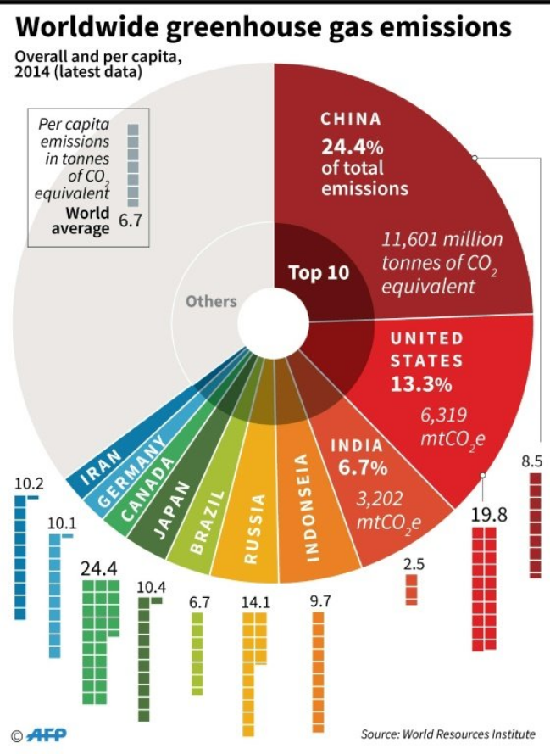
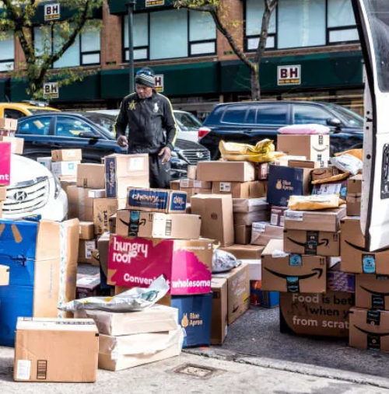
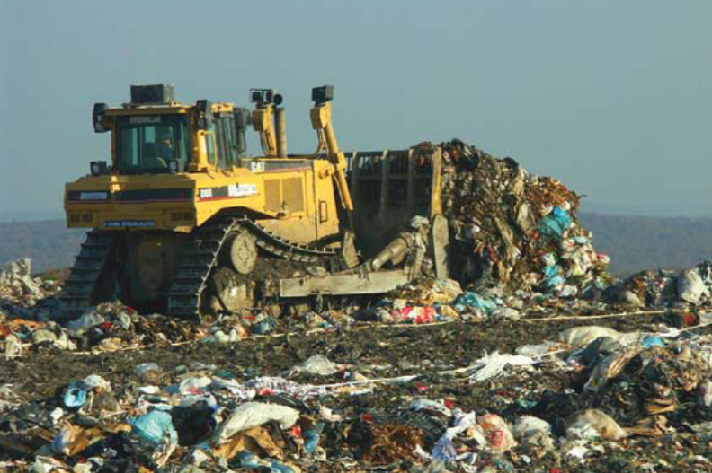
Rita Simon: Sustainable consumption and voluntary mitigating actions
18.9.2024
IACL Conference, Cambridge

Slide 2
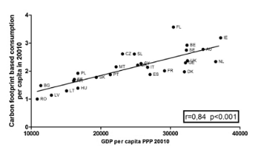
RQ:
How is the sustainability unleashed in the legal regulation mitigating consumption?
„… Rapid and deep changes in final demand would make it easier for every sector to reduce greenhouse gas (GHG) emissions in the short and medium term (high confidence)…“
Sixth Assessment Report of IPCC, Chapter 5
Peleg-Mizrachi/Tal, 2020
10% consumers 49% CO2 footprint0
40% - 44% CO2
50%-7

Slide 3
Content
Unleashing the sustainable consumption argument in legal regulation mitigating consumption
  Mitigating consumption (Consumer Sales Law, Right to Repair Directive)
  Indirectly mitigating consumption (Eco-desing and Energy labeling, Green claims)
Voluntary mitigating actions
Best practices of mitigation policies
Recommendation on demand-side mitigation based on the IPCC Reports
Notes:
First i will unleash
Second, i will report on the best
Third on the voluntary mitigating actions
And finaly based on the IPCC report i will provide some recommendations for policymakers to enhance sustainable consumption

Slide 4
1.1 European framework for promoting responsible consumption
Consumer´s Sales law
Directive on greenwashing – amending the Unfair Commercial Practices Directive
Proposal on Environmental claim Directive
Proposal on right to repair Directive

Slide 5
1.2 Sustainability in the Consumer´s Sales law (incl. Right to repair Directive)
The first Twin-Directive updating European consumer sales law for current challenges (Directive (EU) 2019/770 and 2019/771:
    show very low ambitions towards sustainability
    Nevertheless, some requirements of the Twin Directives enhance sustainable consumption:
        Durability, functionality, compatibility, and in case of digital content available updates become objective criteria for conformity of goods acc. Art. 7 (1) SDG and Art. 8 (1) DCD.
        A two year long legal guarantee period was clarified for digital content and services acc. Art. 11 DCD.
Right to Repair Directive (EU) 2024/1799:
    underlines the importance of sustainability:
    the Directive aims to increase the repair and reuse of viable defective goods purchased by
consumers within and beyond the legal guarantee (for 10 type of products)
  (European Repair Information Form and online Platform for repair)
  Refers on Green Deal and Eco-design Regulation
  ?? Personal profiling, aggressive advertisement
  ?? 14 days withdrawal right
Notes:
The first Twin-Directive updating European consumer sales law for current challenges (Directive (EU) 2019/770 and 2019/771:
show very low ambitions towards sustainability (only two references in the recital), but no references on climate urgency
Nevertheless, some requirements of the Twin Directives enhance sustainable consumption:
First novum is, that durability, functionality, compatibility, and in case of digital content available updates become objective criteria for conformity of goods acc. Art. 7 (1) SDG and Art. 8 (1) DCD.
Second, a two year long legal guarantee period was clarified for digital content and services acc. Art. 11 DCD.
Right to Repair Directive (EU) 2024/1799:
underlines the importance of sustainability:
the Directive aims to increase the repair and reuse of viable defective goods purchased by consumers within and beyond the legal guarantee (for 10 type of products)
(European Repair Information Form and onlin Platform for repair)
Refers on Green Deal and Ecodesign Regulation
by promoting a life cycle of goods which includes re-use, repair and refurbishment, while also producing benefits for consumers by avoiding costs associated with new purchases in the short term.
Dir 2019/771: Ensuring longer durability of goods is important for achieving more sustainable consumption patterns and a circular economy
Right to repair This Directive promotes sustainable consumption with a view to achieving benefits for the environment, by promoting a life cycle of goods which includes re-use, repair and refurbishment, while also producing benefits for consumers by avoiding costs associated with new purchases in the short term.
But the side-effects of personal advertisement and profiling (marketing), which leads to Overconsumption is not mentioned.
Similarly as the negative side-effects of the 14 days right to withdraw from a distance or off-premises contract (acc. to Art. 9 of Consumer Rights Directive):
And the hierarchy between replacement and repair in case of defective performance will be not amended.

Slide 6
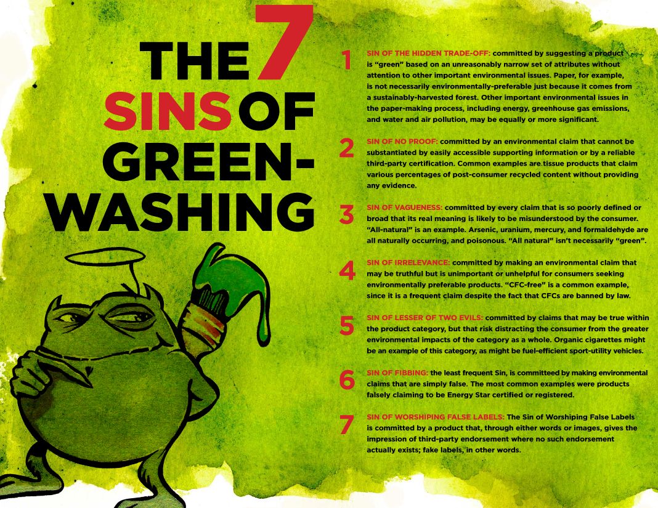
1.3 The sustainability argument in the communication on green content
The Greenwashing Directive (EU) 2024/852 and the Proposal on green claims directive aims:
to establish a coherent policy framework to transform consumption
patterns in a more sustainable direction
to contribute to a greener internal market by encouraging the
competition between traders based on the green content
Directive (EU) 2024/852 UPCD
recognizes the importance of consumers´ informed purchasing decision
based on the green information of the products,
Brings definitions and clarifications for control authorities and courts
Proposal on green claims
Explicitly changes the current post control régime to an ex-ante
companies need to check their environmental statements
in advance and provide comprehensible evidence
ex-ante verification procedures by independent, accredited test centers

Slide 7
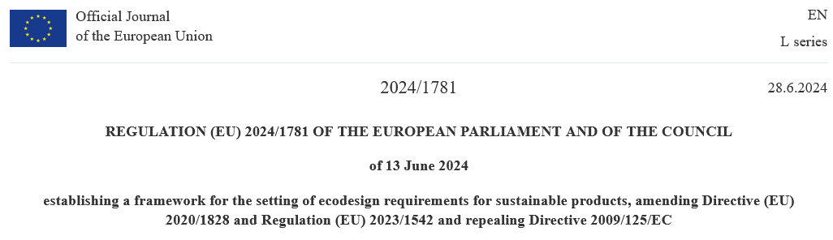
1.4 European framework for promoting responsible production
Eco-Design Directive (Directive 2009/125/EG on energy-related products and Regulation (EU) 2019/2021) on the specification of requirements for the eco-design of electronic displays (in force since March 1st, 2021) Delegated Regulation (EU) 2019/2013 on energy labeling for electronic displays (smartphones from 2025)
Energy labeling of household appliances (Directive 92/75/EEC, Directive 2010/30/EU, Regulation (EU) 2017/1369, Regulation (EU) 2019/2013 etc.)
Eco-Label - voluntary (Regulation (EC) No. 66/2010 on the EU Ecolabel) ISO 14024 on environmental labels and declarations

Slide 8
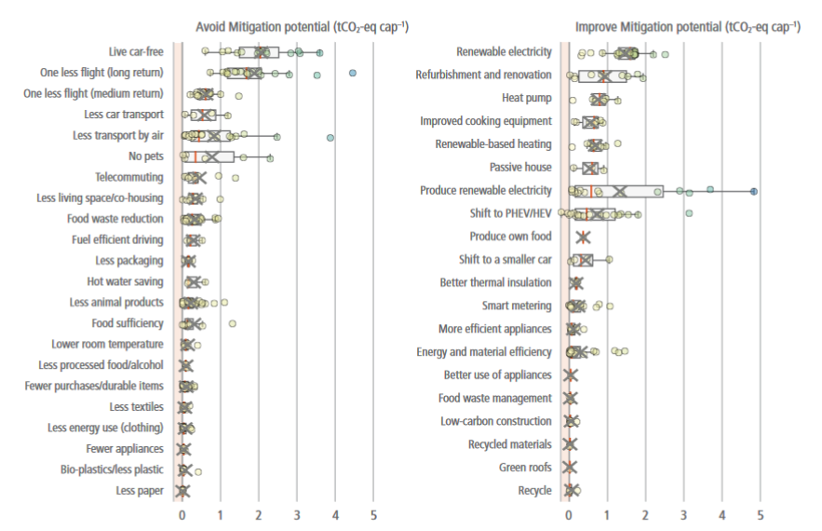
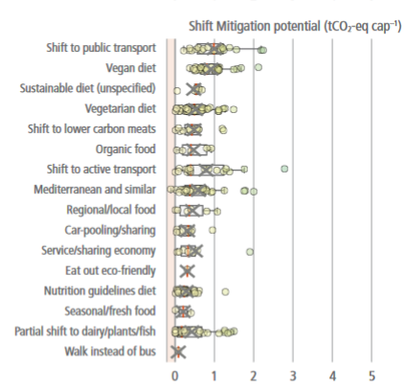
2.1 Demand-side mitigation, with focus of their GHG mitigation potential, IPCC, 6. report, Chapter 5, p.532

Slide 9
2.2 Voluntary mitigating actions of consumers toward sustainable consumption
Voluntary mitigating actions | 2009 | 2017 | 2021 | Effect
reduce waste and separating it for recycling | 30% | 65% | 75% | 0
lower energy consumption is an important factor at buying household appliance | 19% | 35% | 42% | +
consume less meat | n.a. | n.a. | 31 % | ++
environmentally-friendly alternatives to car | 15% | 24% | 30% | ++
travel by train or with low carbon transport vehicle to holidays | n.a. | n.a. | 11% | ++
Cut down water consumption | 11% | 27% | n.a. | +++
Brought product with ecolabel | 19% | 20% | n.a. | +
composed from
Flash Eurobarometer, 2009
Special Eurobarometer 468,
Special Eurobarometer 513
by the author

Slide 10
2.3 Summary on consumers´ voluntary mitigation actions
    The voluntary engagement of consumers towards sustainability is rather low
    The tendency enhances slowly
    Consumers prefers less impactful voluntary actions
„Without adequate incentives or policies, consumers are not likely to be sensitive with respect to their environmental responsibilities.“
(Bastianoni, 2004)
However, consumers cannot sufficient influence production processes and the whole market
system more aware, reduced consumption is necessary

Slide 11
3.1 Best practicies of mitigation policies
Field | Mechanism | Type of mechanism | Country
Transportation | Subsidies for electric cars | Financial | France
 | Free public transport | Financial | Luxembourg
 | Bike to work – tax incentive - premium purchasing | financial | Ireland
Energy | Grants for business investment in sustainable energy | financial | Netherland
Awareness rising - general | Don´t buy It -campaign | School education | Czech Republic
 | Climate education | School education | Slovenia
Durability of household appliances | Repair bonus | financial | France
 | Vouchers, covering 50% of the costs for repairing or renewing electronic equipment | Financial | Austria
Fashion | Environmental surcharge for fast fashion | taxation | France
 | Reduced VAT for repair Services - Shoes, clothing | taxation | Sweden

Slide 12
4. Mitigation policies should aim:
Reduce consumption
(+++)
in general, but especially concerning products with high energy content from “dirty” energy sources
Shift consumption patterns
(++)
to promote services rather than selling products, switch to less burdensome
e-cars-share, library of things, repair cafes
Improve products
(+)
Enhance the eco-desing for products and enable consumers to make an informed decision on more sustainable products
not only tobacco causes problems, but also cars, fuel, aviation, and fast-fashion
Applicable policies: awareness rising campaign, limiting advertisement, pricing mechanism (progressive tax rate/growing unit), better urban planning
Applicable policies: awareness rising campaign, pricing mechanism, subsidies for start-ups (new business models), public transport, green public procurement
Applicable policies: widen Eco-desing requirements, introduce transparent and trustworthy information on CO2 footprint, concerning the whole life-cycle of the good (product passport)
Regional, more energy-efficient, less water consuming, eco, ethical produced products (less polluting and smaller cars, houses)
Notes:
Only a well-constructed mix of different mechanism which whitstands the resistance form stakeholders can be effective.
Following the IPCC concept the mitigation policies should

Slide 13
Summary: General assessment
The European framework for promoting responsible consumption and production aims to enhance sustainability and green the internal market with baby-steps. But: it is questionable whether the speed of this greening will be sufficient to hold up climate change
The voluntary engagement of consumers towards sustainability is rather low
National mitigation policies are uncoordinated and fragmented
A mindset change: Reduce (avoid) – Shift – Improve, as proposed by the IPCC report is not promoted by the EU Directives mitigation consumption. More and far-reaching efforts are necessary.

Slide 14
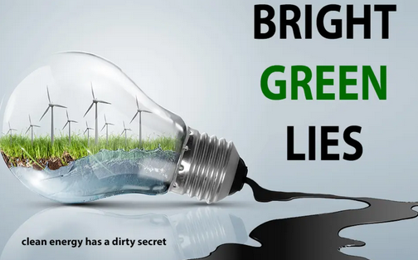
Thank you for your attention!
Contact: rita.simon@ilaw.cas.cz
Please check:
Centre for Climate Law and Sustainability Studies (CLASS)
https://www.ilaw.cas.cz/en/research-and-projects/class/about.html

