Slide 1



ENVIRONMENTAL SUSTAINABILITY AND CONSUMER PROTECTION:
IMPLEMENTING THE SDGS AT LOCAL LEVEL
Rute Couto
Paulo Ventura
Liliana Pinto
1st European Conference of the International Association of Consumer Law
Global Challenges for Consumer Law and Policy in Contemporary Europe
Cambridge, 18.09.2024

Slide 2

2030 AGENDA
A common vision for humanity, a social contract between world’s leaders and the people and "a list of things to do on behalf of the people and the planet“ (Ban Ki-moon)
Approved by 193 UN member states in 2015
It defines global sustainable development priorities and aspirations to achieve by 2030 and seeks to mobilize global efforts around a common set of goals (17) and targets (169)
Rute Couto

Slide 3

PRINCIPLES: THE 5 PS
People: end poverty and hunger in all their forms and dimensions and ensure dignity and equality
Planet: protect the planet natural resources and climate to support the needs of the present and future generations
Prosperity: ensure prosperous and fulfilling lives, in harmony with nature
Peace: foster peaceful, just and inclusive societies
Partnership: implement the Agenda through a revitalized global partnership
Decade of Action (2020-2030): ambition and sense of urgency to accelerate the transition
“Leaving no one behind”
Rute Couto

Slide 4


SDGS
Rute Couto

Slide 5
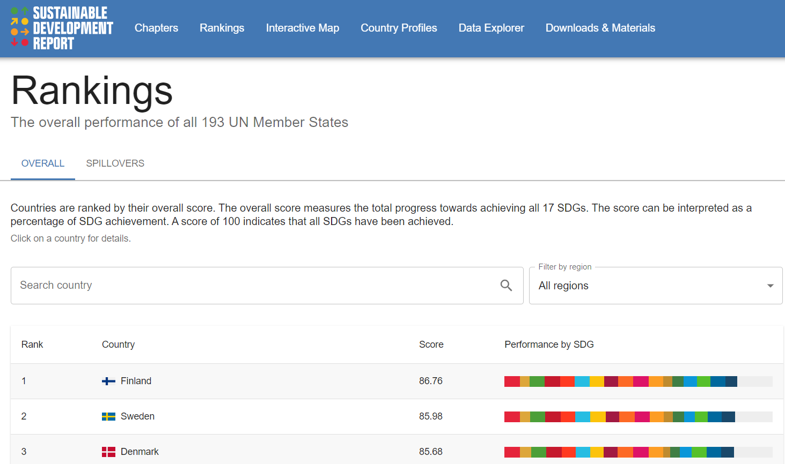
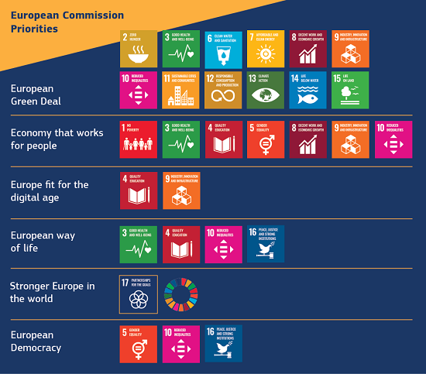
SDGS
6 Commission priorities for 2019-24
Portugal (16th)
Rute Couto
https://dashboards.sdgindex.org/rankings

Slide 6

GOAL 12: ENSURE SUSTAINABLE
CONSUMPTION AND PRODUCTION PATTERNS
Rute Couto

Slide 7



GOAL 12: ENSURE SUSTAINABLE
CONSUMPTION AND PRODUCTION PATTERNS
PRODUCTION
CONSUMPTION
EMPOWERMENT FOR SUSTAINABILITY
Sustainable management and efficient use of natural resources (12.2)
Environmentally sound management of chemicals and wastes (12.4)
Substantially reduce waste generation (12.5)
10-Year Framework of Programmes on Sustainable Consumption and Production Patterns (12.1)
Halve per capita global food waste (12.3)
Sustainable public procurement practices (12.7)
Encourage companies to adopt sustainable practices and sustainability reports (12.6)
Awareness for sustainable development and lifestyles (12.8)
Tools to monitor sustainable development impacts for sustainable tourism (12.b)
Rute Couto

Slide 8






EUROPEAN CONSUMER AGENDA 2020-2025
Strengthening consumer resilience for sustainable recovery (COM(2020) 696final)
Empower european consumers to play an active role in the green and digital transition
Five key priority areas: 1) Green transition; 2) Digital transformation; 3) Redress and enforcement of consumer rights; 4) Specific needs of certain consumer groups; 5) International cooperation
Rute Couto

Slide 9
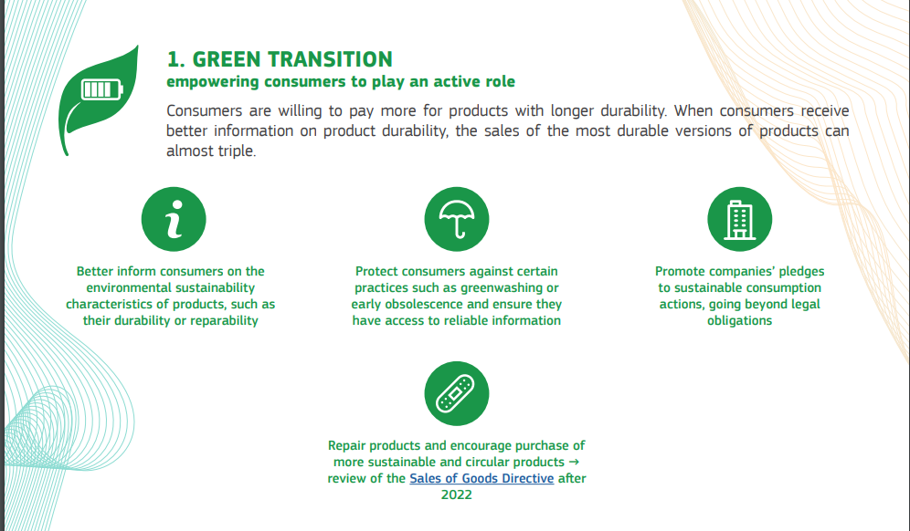
EUROPEAN CONSUMER AGENDA 2020-2025
Addressing specific consumer needs: support to “initiatives providing local advice to consumers, who for structural or personal reasons do not have access to support and information provided online or at central information offices”, including in remote areas
Rute Couto

Slide 10

EMPOWERING CONSUMERS
Empowering consumers for the green transition through better protection against unfair practices and through better information (Directive EU 2024/825)
“Empowering consumers for the green transition means giving European citizens the tools to make informed choices and preventing practices such as greenwashing and early obsolescence from being used in the single market” ( Vera Jourová)
Reliable information on durability and reparability
Trusted information on product sustainability
Transparency on early obsolescence
A verified sustainability label
Rute Couto

Slide 11


EUROPEAN COMMITTEE OF THE REGIONS (COR)
Advisory body representing Europe's regional and local authorities
Opinion of the CoR on the New Consumer Agenda (2022/C 61/07): involvement of local and regional authorities in empowering consumers for the ecological transition (information spreading, promotion of new consumption patterns and behaviors, consumer education, creation of financial incentives for environmental progress and support for SMEs and small local producers in this transition)
“Green Deal Going Local” working group: place cities and regions at the heart of policies
Rute Couto

Slide 12

SDG LOCALIZATION
Transforming the SDGs into reality at the local level, in line with communities’ priorities
“The SDGs localization is the process of translating the 2030 Agenda for Sustainable Development within the local context and challenges, defining, implementing and monitoring local actions and strategies that contribute to the global achievement of the SDGs” (Urban Data Platform Plus)
It is estimated that 65% of the 169 targets set for the SDGs will not be achieved without the concrete involvement of regional and local governments (UN Sustainable Development Solution Network)
Two-way process
Rute Couto

Slide 13
SDG LOCALIZATION
“Top-down” (from global to local), as the SDGs frame and guide local development policies
“Bottom-up” (from local to global), as local governments contribute to the achievement of the SDGs through their policies and actions
Rute Couto
Source: Rede Intermunicipal de Cooperação para o Desenvolvimento (RICD)

Slide 14

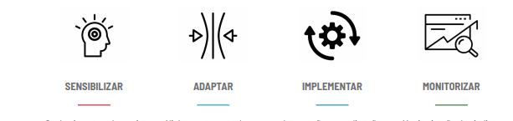
MUNICIPALITIES AND THE SDGS
Local action for global transformation
Recommendations for implementing the 2030 Agenda: “get political support; involve all municipal departments and create multidisciplinary teams; integrate the SDGs into daily work and day-to-day management; take advantage of existing participation mechanisms to involve local actors; invest in disaggregated statistical data that allows monitoring; promote the sharing of knowledge and experiences between municipalities, through participation in networks and decentralized cooperation” (RICD)
Phases: raise awareness – adapt – implement – monitor
https://rumoa2030.pt/
Rute Couto

Slide 15


PORTUGAL
Municipal Sustainability Index (ISM): measuring the degree of sustainability in each municipality in the country, assessing Sustainable Development in municipal areas
LocalSDG - Municipal Platform on Sustainable Development Goals: monitoring the progress of Portuguese municipalities in relation to the various SDG targets through progress indicators and mapping good municipal practices (https://odslocal.pt/)
Rute Couto

Slide 16
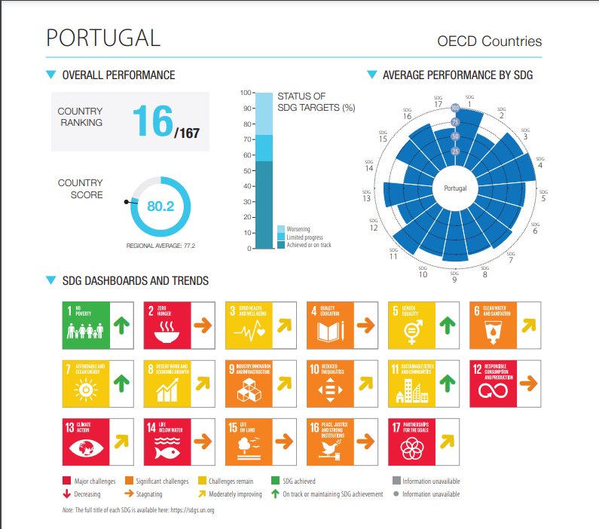
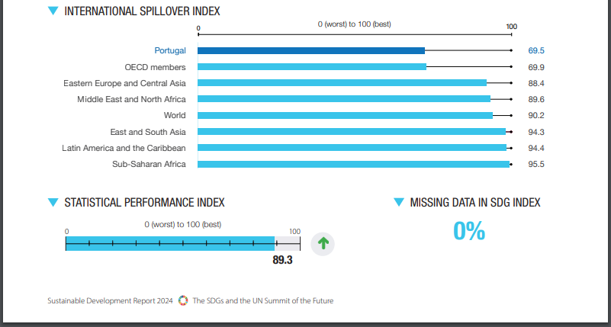
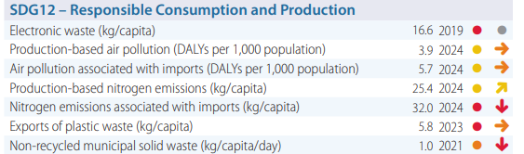
SUSTAINABLE DEVELOPMENT REPORT 2024
Rute Couto

Slide 17
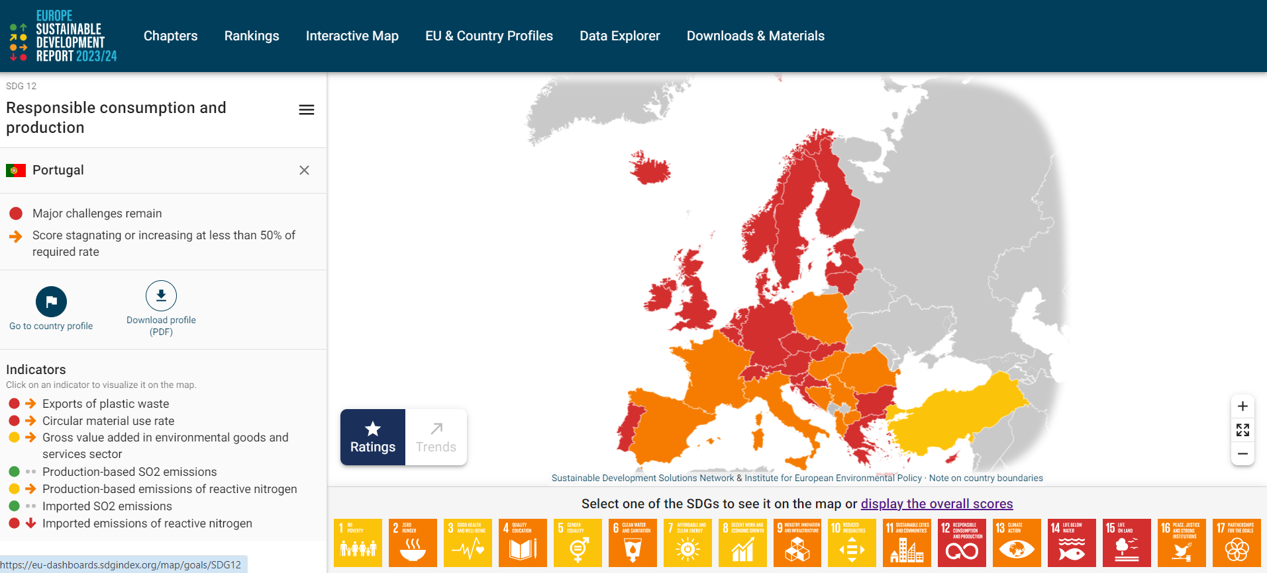
SUSTAINABLE DEVELOPMENT REPORT 2024
Rute Couto

Slide 18

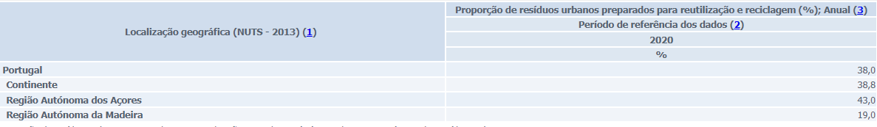
TARGET 12.5: REDUCE WASTE GENERATION THROUGH PREVENTION, REDUCTION, RECYCLING AND REUSE
Proportion of municipal waste prepared for reuse and recycling
Top 3 municipalities
  Ferreira do Zêzere (92,7%)
  Constância (91,7%)
  Entroncamento (90,1%)
Bottom 3 municipalities
  Mesão Frio (3,3%)
  Alijó (6,9%)
  Resende (8,5%)
Rute Couto

Slide 19

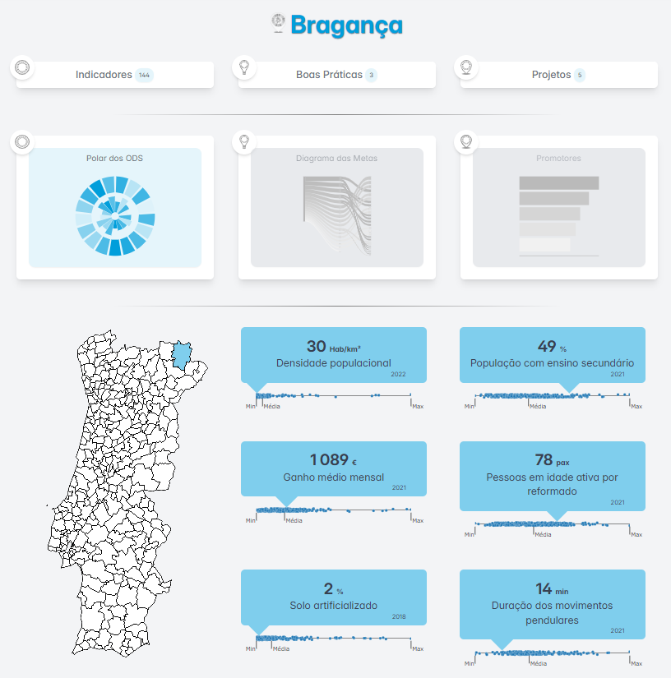
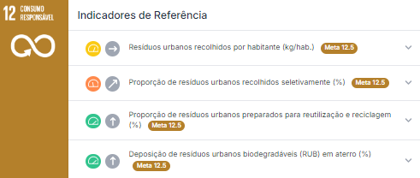
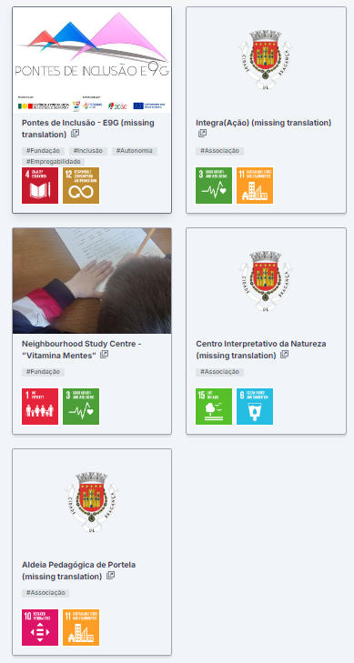
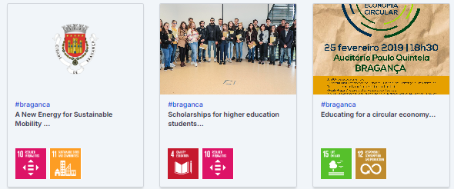
LOCAL SDG PLATFORM
Rute Couto

Slide 20





CHALLENGES FOR LOCAL AUTHORITIES
INEFFICIENT WASTE MANAGEMENT
PUBLIC AWARENESS AND EDUCATION
FINANCIAL CONSTRAINTS
LACK OF SUSTAINABLE URBAN PLANNING
LOW ADHERENCE TO CIRCULAR ECONOMY PRACTICES
Rute Couto

Slide 21





OPPORTUNITIES FOR LOCAL AUTHORITIES
CIRCULAR ECONOMY AND TECHNOLOGICAL INNOVATION
PARTNERSHIPS WITH THE PRIVATE SECTOR
INCENTIVES FOR SUSTAINABLE MOBILITY
SUPPORT FOR LOCAL AND SUSTAINABLE MARKETS
IMPLEMENTING DIGITAL TOOLS
Rute Couto

Slide 22

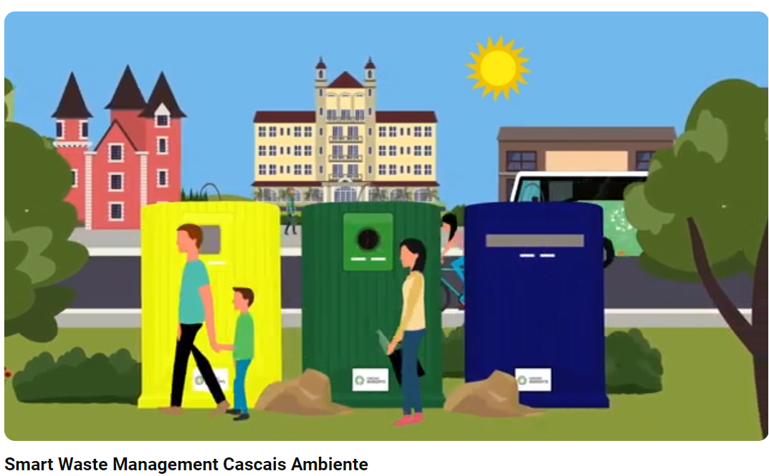


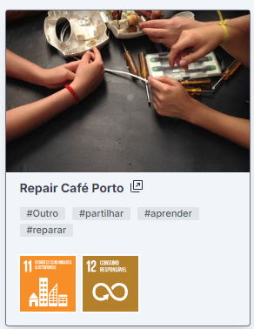
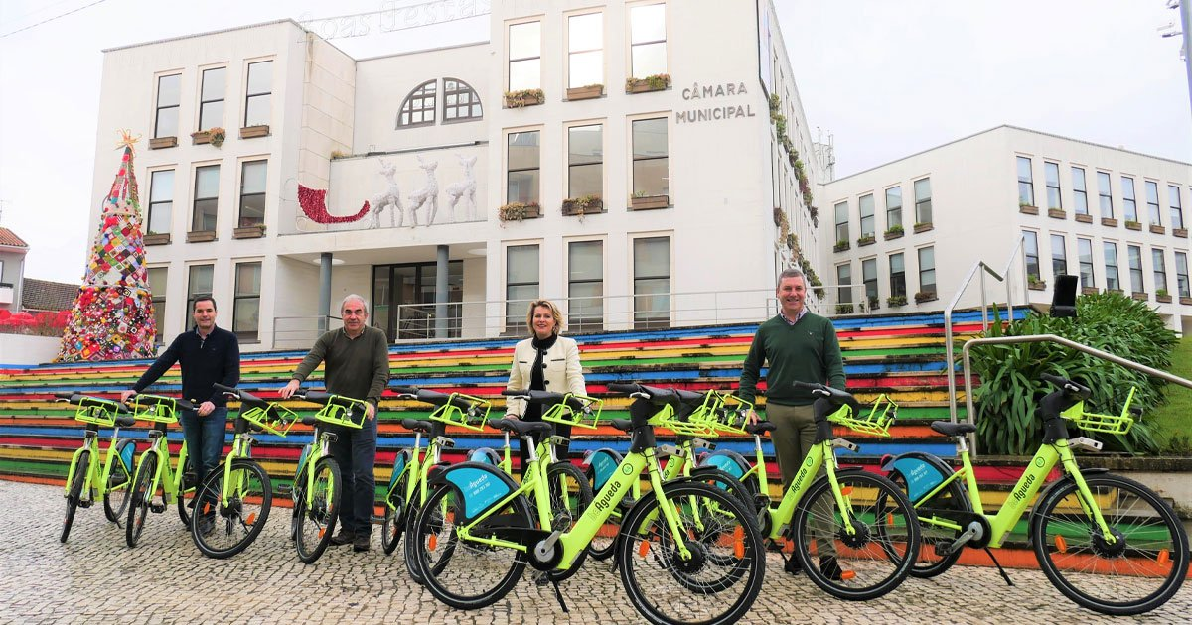

GOOD SUSTAINABLE CONSUMPTION PRACTICES
AT MUNICIPAL LEVEL
Intelligent waste management system
Distribution of community composters
Literacy plans to combat food waste
Sustainable mobility policy (bicycle lanes, electric public transport, shared bicycles)
Renewable energy in public spaces and municipal buildings
Sustainable local trade and trade in second-hand goods
Rute Couto

Slide 23

“Our fight for global sustainability will be won or lost in the cities.”
(Ban Ki-moon)
Rute Couto

Slide 24

Thank you
Rute Couto rute@ipb.pt
Paulo Ventura paulojcv@sapo.pt
Liliana Pinto lfsp2811@gmail.com
Rute Couto

