Slide 1
Banning Planned Obsolescence and Building a Right to Repair
Trish O’Sullivan
Massey University
Auckland
New Zealand

Slide 2
Consumer NZ Survey
2022, Consumer NZ purchased five kitchen mixers from various retailers in Wellington - Kmart (Petone and Porirua), The Warehouse, Briscoes, and Farmers.
The testing team deliberately caused easy-to-fix faults by removing a power wire from the control board of the mixers and placed tracking devices in each mixer before returning them to the store of purchase.
On returning the faulty mixers, Kmart, The Warehouse, and Briscoes offered refunds, while Farmers offered a replacement mixer.
The tracking devices were monitored for four months to track the fate of the mixers:
Kmart – Petone landfill
Kmart – Porirua landfill
The Warehouse landfill
Briscoes appliance outlet – seller of refurbished appliances
Farmers recycling centre
60% went straight to landfill – a concerning statistic given these appliances only needed only a simple repair.
https://www.consumer.org.nz/articles/broken-appliances-are-they-repaired-or-dumped

Slide 3
Issues
Planned obsolescence: products deliberately designed not to last, or unable to cope with software updates –– business model focused on profit and selling more product.
Use of software locks to prevent repair by unauthorised repairers or predetermine life of product - “bricking”
Some products designed to make repair difficult - parts glued together - rather than screwed, need special tools - can’t use standard screw drivers etc. Can’t be taken apart and easily reassembled.
Limited access to repair manuals, spare parts and digital diagnosis tools or passwords – controlled by manufacturers.
Environmental harm – waste creation and unsustainable use of precious resources.
https://techcrunch.com/2023/04/25/colorados-new-right-to-repair-law-ensures-tractor-and-wheelchair-owners-get-the-parts-they-need/

Slide 4
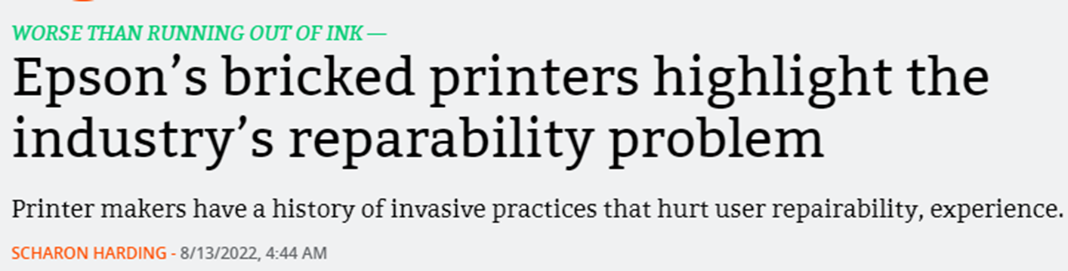

https://arstechnica.com/gadgets/2022/08/epsons-bricked-printers-highlight-the-industrys-reparability-problem/

Slide 5
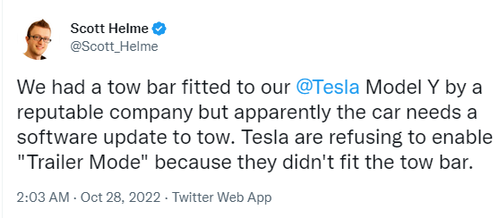
Manufacturer control …

Slide 6
Gaps in NZ Consumer Guarantees Act 1993
Consumer cannot insist on repair (even if failure of a substantial character). If good can be repaired, supplier chooses whether to repair, replace or refund – s.18 CGA
No right to repair if consumer guarantee rights expired – even if consumer happy to pay for repair.
Uncertainty on durability - acceptable quality guarantee requires goods to be as durable as a reasonable consumer would expect taking account of factors such as price, supplier statements – s.7 CGA.
Can avoid access to repairs/spare parts requirement if give notice at point of sale – s.43 CGA.
No prohibition on planned obsolescence
Right to Repair Bill NZ
https://www.legislation.govt.nz/bill/member/2024/0039/3.0/LMS952537.html

Slide 7




UE and UK Right to Repair
Specific household appliances – obligation on manufacturers to ensure that repair manuals and spare parts are available for a certain number of years - after the last item has been placed on the market:
washing machines (10yrs), dryers (10yrs), refrigerators (7yrs), dishwashers (7yrs), electronic displays (televisions and monitors) (7yrs), servers and data storage products (8yrs), mobile phones/tablets (7yrs).
Must be repairable for periods of 7-10 years

Slide 8
Conclusions for NZ
Changes to CGA and new regulation – to encourage repair and ban planned obsolescence.
Changes to copyright law – creating exceptions to enable 3rd party repairer access to repair manuals, spare parts and diagnostic tools without breaching copyright.
New Right to Repair law – repair obligations for specific products for set time frames – see EU/UK. Start with common household appliances
Support development of a thriving repair service industry and 2nd hand product market – sustainable business models.
Change in society’s attitudes – move away from a “throw-away society” and ideas that the “latest is the greatest” - towards seeing value in preservation and longevity of products - make extending the life of products an aspiration.
T O’Sullivan and Alex Sims, A Right To Repair For New Zealand (2024) 30 Competition and Consumer Law Journal 239

Slide 9

EU Regulation Planned Obsolescence - Ecodesign framework adopted 13 June 2024 https://eur-lex.europa.eu/legal-content/EN/TXT/?uri=CELEX%3A32024R1781&qid=1719580391746
https://commission.europa.eu/energy-climate-change-environment/standards-tools-and-labels/products-labelling-rules-and-requirements/sustainable-products/ecodesign-sustainable-products-regulation_en

Slide 10
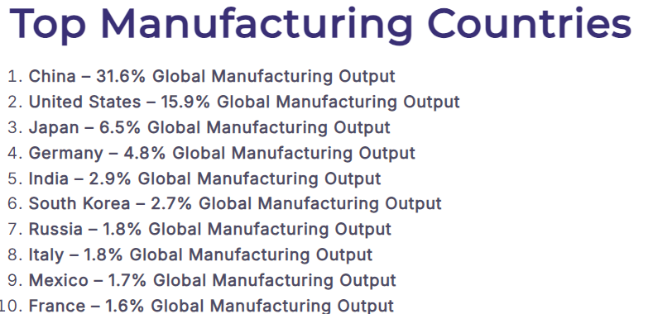
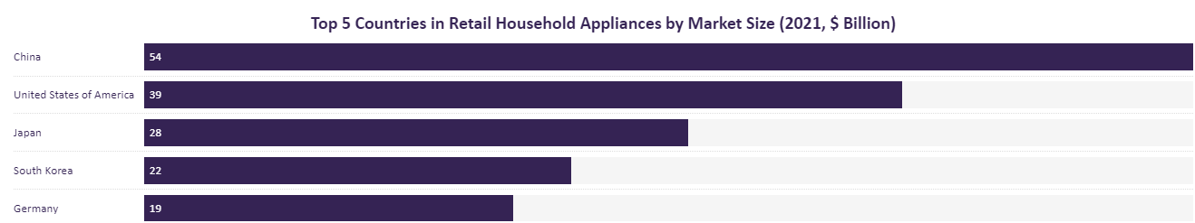
Final Thoughts
How do we get to the global manufacturing giants?
UN treaty ban on planned obsolescence? https://sdgs.un.org/goals/goal12

Slide 11
