Slide 1
Redefining Equality in European Contract Law
Prof. Vanessa Mak | IACL conference 17-18 September 2024

Slide 2
Research question
Do we need to redefine the principle of equality in European contract law in order to correct for new inequalities arising between consumers and businesses in an economy based on services and experiences rather than the sale of physical goods? And if so, how?

Slide 3
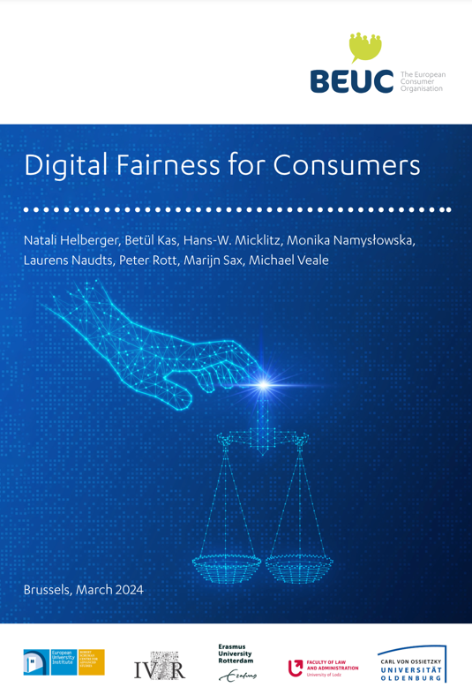
Why this question?
See for illustration BEUC report, Digital Fairness
‘a rupture taking place in the digital economy, which shatters established wisdoms in the design and understanding of consumer law’ (p. 8)
At least four ‘ruptures’
- vanishing line between the consumer and the citizen
- privatisation of consumer law
- fundamental rights and ‘fairness’ – placeholders only?
- knowledge gap consumer/industry, burden of proof
[on privatisation and consumer contract law see also Mak, Legal Pluralism in European Contract Law, OUP 2020]

Slide 4

The problem
Phases of development of the EU consumer market:
- physical goods
- services
- ‘experiences’
Image by freepik.com.

Slide 5


The law
Development of EU consumer law acquis
1970-2019, contract and tort law
From 2020:
Towards a ‘post-consumer society’
Post-consumer regulation treats digital markets/platforms as a separate area of the consumer acquis (cf. DSA and DMA)
Risk of a gradual split between the ‘logic of the consumer’ and the ‘logic of the platforms’ whilst user/consumer are usually the same person (cf. Grochowski 2023)
Micklitz: ‘dissolution of consumer law’

Slide 6

Consumer law back to being Snow White?

Slide 7

In search of answers… how? (1)
Reassessing the state of play of consumer protection in European contract law
Why contract law? Because:
market ordering: it is instrumental to market ordering (albeit with different connotations in national legal systems vs. EU law)
doctrinal private law & interests: its system of rules, principles and practices provides guidance on how to balance the interests of private parties
weaker party protection: it has been the primary framework for weaker party protection (not only for consumers but also workers, tenants, patients)
EU law: the EU consumer law acquis is primarily directed at B2C contractual relationships
Image by freepik.com.

Slide 8

In search of answers… how? (2)
Redefining equality
Why equality? Because:
autonomy: contract law aims to safeguard parties’ autonomy
corollary principles: freedom of contract & equality
Image by freepik.com.

Slide 9
Defining autonomy and equality
National contract laws | European contract law
Autonomy as self-realisation | ‘Framed autonomy’ – balanced with objectives of EU law with higher or equal ranking
Corollary principles: freedom of contract & equality | Freedom of contract reflected in some Charter provisions, equality as a general principle of EU law
Respect for autonomy of the other party justifies curtailing the freedom of contract (e.g. by introducing mandatory consumer protection rules) | Instrumentalist nature of European private law cuts across doctrinal systems
Weaker party protection as part of internal logic of contract law | Ad hoc development of European contract law
Weaker party protection also sometimes justified by societal goals in relation to market ordering | Weaker party protection as part of the pursuit of the integration of the EU internal market
Private law primarily aimed at corrective justice | Private law used in the pursuit of social justice
Specific rules aimed at categorical protection | Specific rules aimed at categorical protection
General rules and principles in contract law as a safety net (e.g. good faith) | Some general principles of private law & EU Charter of Fundamental Rights

Slide 10

‘Islands and the Ocean’ (cf. Michaels)
Image by freepik.com.

Slide 11

‘Stoomwals’ (cf. Hijma)
Image by freepik.com.

Slide 12

But also: EU law as a catalyst
Harmonized consumer law throughout the EU
Minimum level of consumer protection, and in some cases full harmonisation
Further legal development through the case law of the Court of Justice of the EU
Potential for additional protection based on the EU Charter of Fundamental Rights
Image by freepik.com.

Slide 13
Equality in European contract law
Where are we now?
Achievements of EU law:
- harmonized rules on consumer sales law relating to conformity, remedies, guarantees,
burden of proof
- similar rules for contracts for digital content
- for services, sector-specific protection of consumers in energy, telecom and credit markets
- ‘access justice’ ensured so that the ‘average consumer’ can reap the benefits of the internal
market
- general protection through the Unfair Contract Terms Directive (UCTD) and the Unfair
Commercial Practices Directive (UCPD)
Is it enough?

Slide 14

Equality in digital markets
New forms of inequality:
misleading commercial practices, ‘dark patterns’
restrictions to freedom of expression on social media platforms
(almost) no remuneration for content creation
Can European consumer / contract law provide solutions?
Image by freepik.com.

Slide 15
Misleading practices / dark patterns
Existing regulation may provide solutions
With regard to economic interests of consumers:
Unfair Commercial Practices Directive (UCPD)
With regard to ‘dark patterns’:
Digital Services Act (DSA) – prohibition for online platforms, Art. 25
Data Act – prohibition for data holders and third parties, recital 38,
Art. 4(4) and 6(2)(a)
AI Act (proposal) – prohibition of placing on the market or putting to
use AI systems using subliminal techniques, recital 16, Art. 5(1)(a)
Dark pattern:
‘Dark patterns on online interfaces of online platforms are practices that materially distort or impair, either on purpose or in effect, the ability of recipients of the service to make autonomous and informed choices or decisions.’
DSA, recital 67

Slide 16
Freedom of expression: restrictions in T&C
Restrictions to users’ freedom of expression in social media platforms’ terms and conditions
Art. 14(4) DSA – application and enforcement of restrictions to freedom of expression laid down in an intermediary service’s T&C
‘providers of intermediary services shall act in a diligent, objective and proportionate manner
in applying and enforcing the restrictions (…), with due regard to the rights and legitimate
interests of all parties involved, including the fundamental rights of the recipient of the
service, such as the freedom of expression, freedom and pluralism of the media, and other
fundamental rights and freedoms as enshrined in the Charter.’
But: private regulation and enforcement can be risky…

Slide 17

Freedom of expression (cont.)
National courts are searching for solutions: extending the application of the UCTD and the UCPD to cases involving contractual restrictions on the freedom of expression
Bundesgerichtshof (BGH), 29 July 2021, III ZR 179/20 and III ZR 192/20
Italian Administrative Court of Appeal (Lazio), 10 January 2020, no. 261
Also at the European level, an opening to extend the application of consumer and competition law to issues of data protection, as long as the claim is related to infringements of economic interests
Case C-252/21 Meta Platforms Inc v. Bundeskartellamt, ECLI:EU:C:2023:537
Could the EU Charter of Fundamental Rights be a catalyst for further
developments?
Image by freepik.com.

Slide 18


Remuneration for content creation
Use value
qualitative value, the usefulness of a commodity
Exchange value
quantitative value, the value of a commodity on the market

Slide 19
Remuneration for content creation (cont.)
Problem: “It’s difficult to think of prosumers as exploited. This idea is contradicted, among other things, by the fact that prosumers seem to enjoy, even love, what they are doing and are willing to dedicate long hours to these activities without receiving anything.” (Ritzer & Jurgenson 2010)
Should economic interests be reconceptualized to include not just remuneration for exchange value but also for use value?
still some problems to solve, e.g. how to quantify which amount of remuneration should be
awarded to users in light of the profits generated by online platforms…

Slide 20
Research question
Do we need to redefine the principle of equality in European contract law in order to correct for new inequalities arising between consumers and businesses in an economy based on services and experiences rather than the sale of physical goods? And if so, how?
YES! And we have found some answers…

Slide 21

The road ahead
Challenges for the European legislator…
- should the consumer acquis be revised, with a specific focus on the question whether contract law can
extend its protection beyond the economic interests that it currently relates to?
- perspectives on the political economy underlying European contract law lend support to such
directions (cf. Bartl, Hesselink, Pistor)
… and further opportunities through litigation
- experiments by national courts, potential for using the preliminary reference procedure of the CJEU
as ‘an open goal mouth’ for the pursuit of consumer protection (cf. Micklitz)
- the EU Charter of Fundamental Rights as a catalyst

Slide 22
Thank you!

