Slide 1
'Consent or Pay'
Equivalent alternatives or
a false dilemma?
Vassilis Karkatzounis | Dr. Evangelos Margaritis

Slide 2
The online advertising industry
€96.9 billion
Over 60%
$30.9 billion
European Digital Advertising Market in 2023
of global digital advertising revenue is generated by Google, Meta, and Amazon
Meta's revenue across Europe in 2023

Slide 3
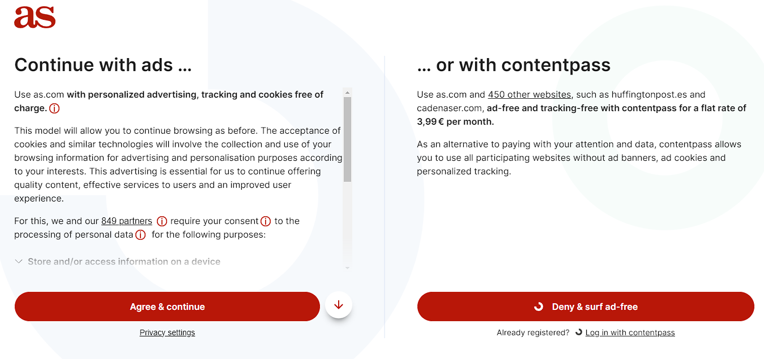
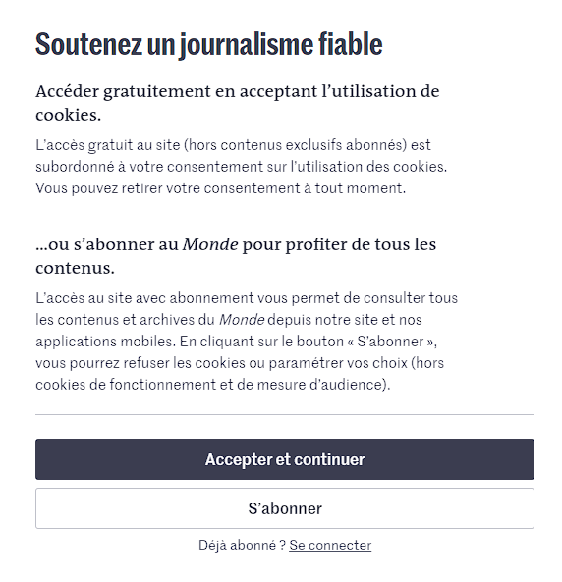
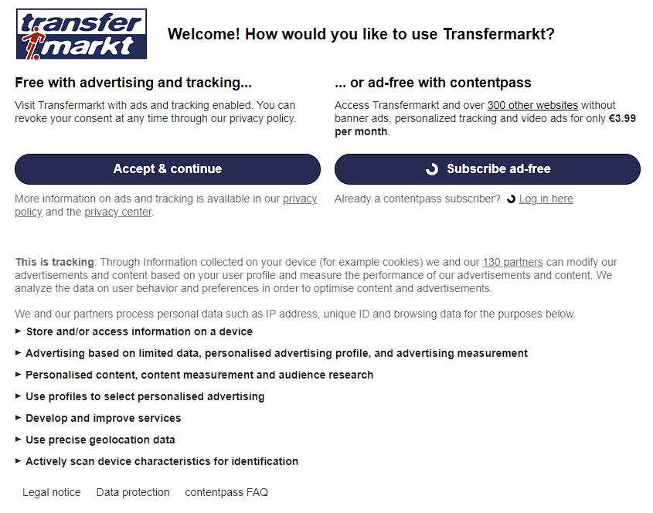
The rise of paywalls
Already deployed by various websites, a rather popular business model among news websites throughout Europe for many years.
Websites offer users a choice between (at least) two options to gain access to online services/content:
1) consent to the processing of personal data for a specified purpose (usually Behavioural Advertising), or
2) pay a fee without their personal data being processed.
Multiple Data Protection Authorities of EU member states have issued related guidelines, including France, Austria, Denmark and Germany.
No general prohibition - Criterias for fees, etc.

Slide 4
Meta ‘Consent or Pay’ timeline
Irish DPA Decision Contract is not a valid legal basis for OBA
ECJ Bundeskartellamt
Limits on contract, legitimate interest …
and consent
EDPB Urgent Decision Ban OBA on the basis of contract and legitimate interest
Meta Consent or Pay
Meta turns to consent and launches Pay or OK
EDPB Opinion 08/2024
A binary choice is not enough for valid consent
EC & Digital Markets Act
A binary choice forces users to consent - Violation of the DMA?
Consumer Protection
EC coordinates action by consumer protection authorities
Meta goes to the ECJ
Annul the EDPB Opinion
(Case T-319/24)

Slide 5
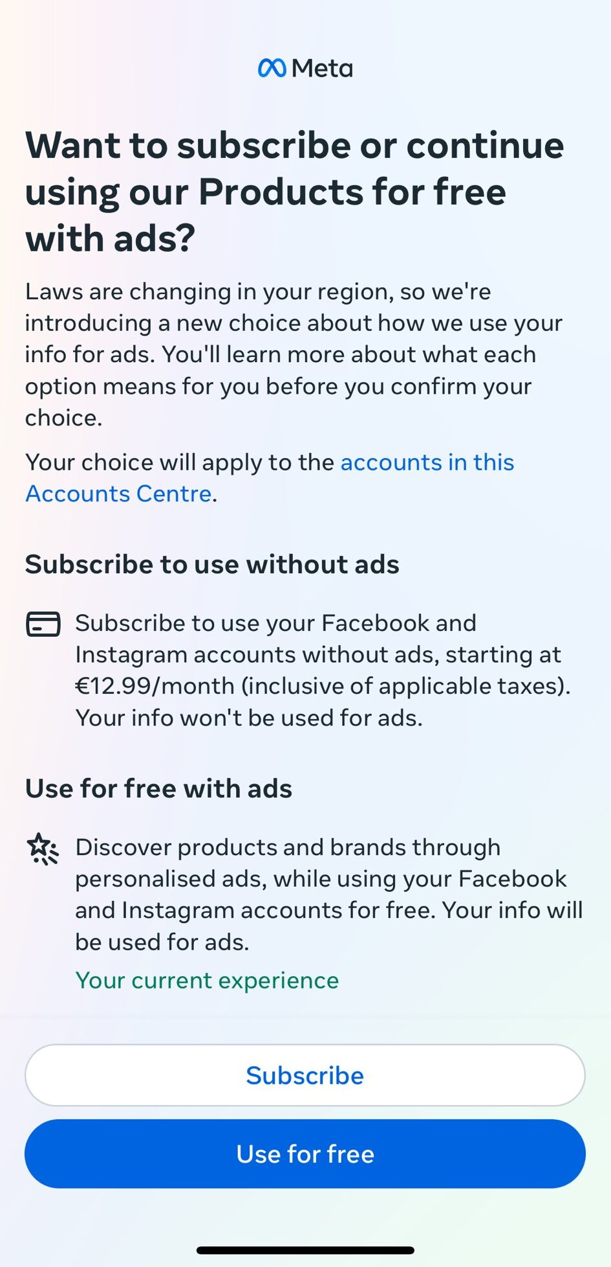
EDPB Opinion 08/2024
In most cases, Consent or Pay models by “Large Online Platforms” do not meet the requirements for valid consent under the GDPR.
Features and frictions of consent:
Freely given, specific, informed, unambiguous.
A real choice? Conditionality, detriment, imbalance of power and granularity.
Equivalent alternative: Not only a paid alternative but also a less privacy intrusive form of advertising.
Personal data should not be viewed as a tradeable commodity - a fundamental right users should not have to pay to enjoy.

Slide 6
Meta ‘Consent or Pay’ timeline
Irish DPA Decision Contract is not a valid legal basis for OBA
ECJ Bundeskartellamt
Limits on contract, legitimate interest …
and consent
EDPB Urgent Decision Ban OBA on the basis of contract and legitimate interest
Meta Consent or Pay
Meta turns to consent and launches Pay or OK
EDPB Opinion 08/2024
A binary choice is not enough for valid consent
EC & Digital Markets Act
A binary choice forces users to consent - Violation of the DMA?
Consumer Protection
EC coordinates action by consumer protection authorities
Meta goes to the ECJ
Annul the EDPB Opinion
(Case T-319/24)

Slide 7

Consumer Protection Issues & CRD
Obligation to pay must be clear enough
Unambiguous formulation of the button
Distance Contracts (Dir. 83/2011/EU “CRD”)
Obligation to pay must be clear enough
OLG Düsseldorf, Decision of 08.02.2024 - 20 UKl 4/23 (interim measures), following an desist lawsuit by North Rhine-Westphalia Consumer Center.
The button must consist of the words "order with obligation to pay" or another corresponding, unambiguous formulation. ECJ C‑249/21: Only the words that appear on that button or that similar function should be taken into account.
Facebook Website
Facebook iOS APP
The word "subscribe" is not clear in this sense because there are also free subscriptions (e.g. for so-called newsletters). The fact that the website clearly indicates before and during the subscription that the subscription is subject to a fee is irrelevant.
The content of this button clearly shows that the service is subject to payment.
Consumer perception most likely not a binding declaration of intent but redirecting to another page where he can enter the necessary payment details and then place the binding order.

Slide 8
Misleading Commercial Practice?
The key question from the consumer protection law POV:
What is the expectation of the average consumer in a public statement from a digital service provider a paid subscription is “Ads Free”
Exemption from online behavioural advertising only, or from every form of targeted (incl. segmented/ contextual)?
Or full exemption from ads?
Still tracking for other purposes?
To track or not to track?
The evaluation of the service provider’s statement “we change or model because… laws are changing in your region…”
Which exactly law has changed?
Would those declarations or omissions to declare crucial info detriment the average consumer’s ability to meet an informed choice for a transactional decision?

Slide 9
Aggressive Commercial Practice?
The key question:
Does this practice qualify as an
“undue influence” exercise from the
service provider?
What are the factors to assess this commercial practice?
To sacrifice a considerable pecuniary amount or to succumb to a seamingly “free” provision of services.
Exclusion Risk Vs the amount of annual fee
The role of some social media as “gatekeepers”/core platform services and quasi
BEUC: forced subscription practice and should be seen as a dark pattern which unduly pushes the consumer to agreeing to one of the presented options without being able to exercise a free and informed choice.
The balance test between (cost of the “AdFree” experience/ fee) seems to fail.
Undue influence on the average consumer
leading to a transactional decision (in the means of the decision not to pay).
The UCPD might be proven to be “digital fit” if EU/ national courts accept this viewpoint.

Slide 10
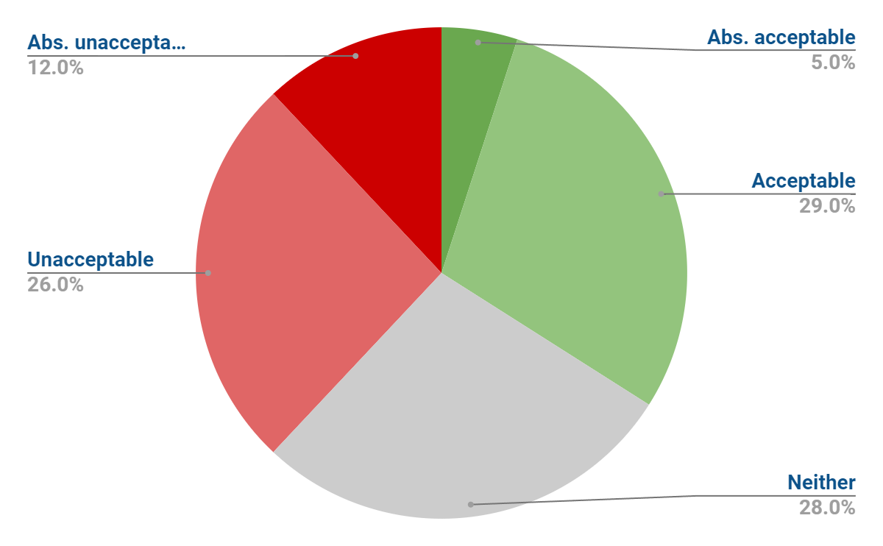
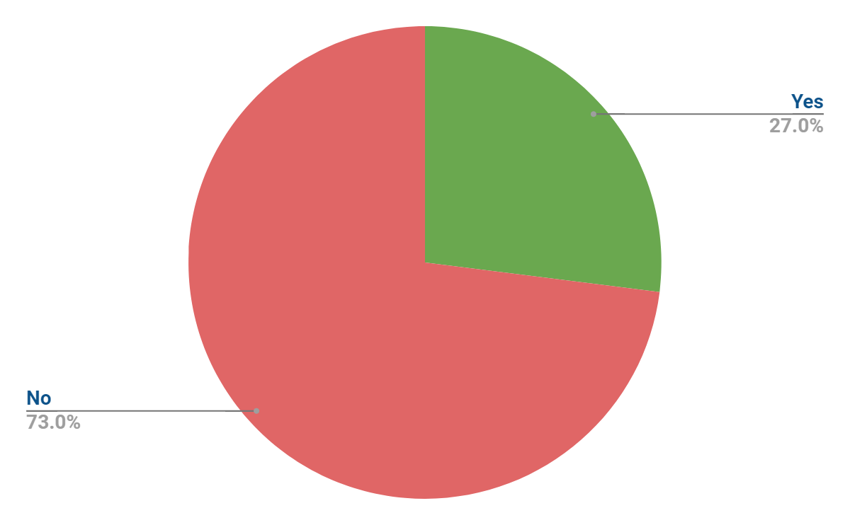
Users’ expectations
A website allows you to browse for free and in return shows advertisements based on your personal data: Is this acceptable or unacceptable?
Would you prefer to pay a financial fee instead of providing your personal data to these websites?
Research conducted by the O.B.A.M.A. project, supported by the Hellenic Foundation for Research and Innovation

Slide 11
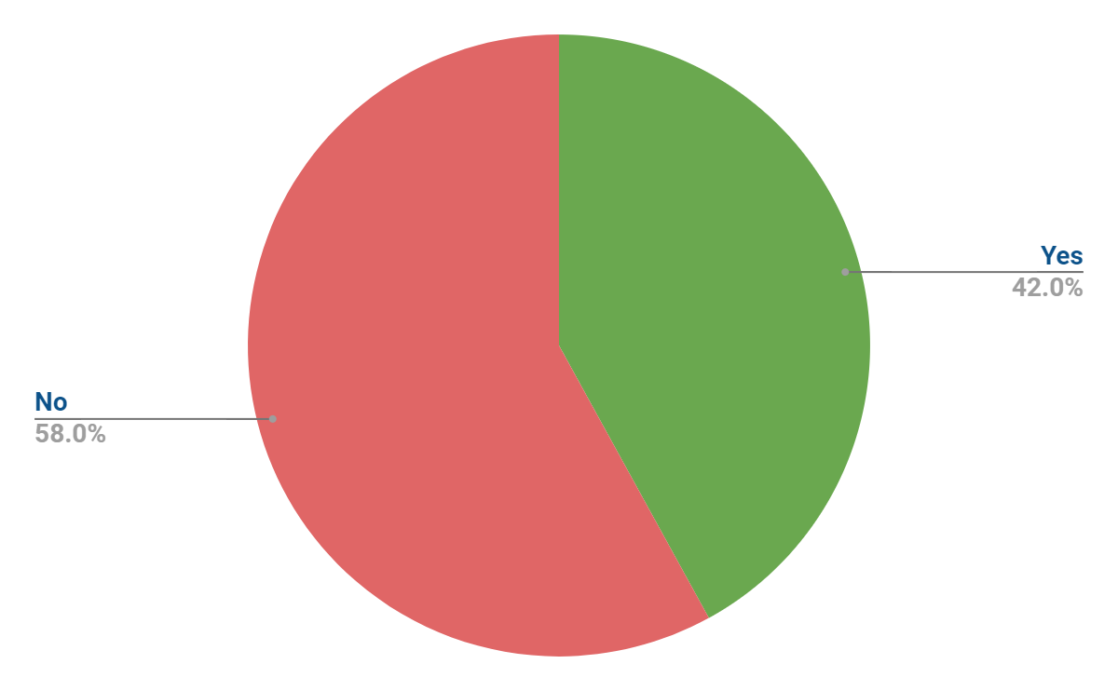
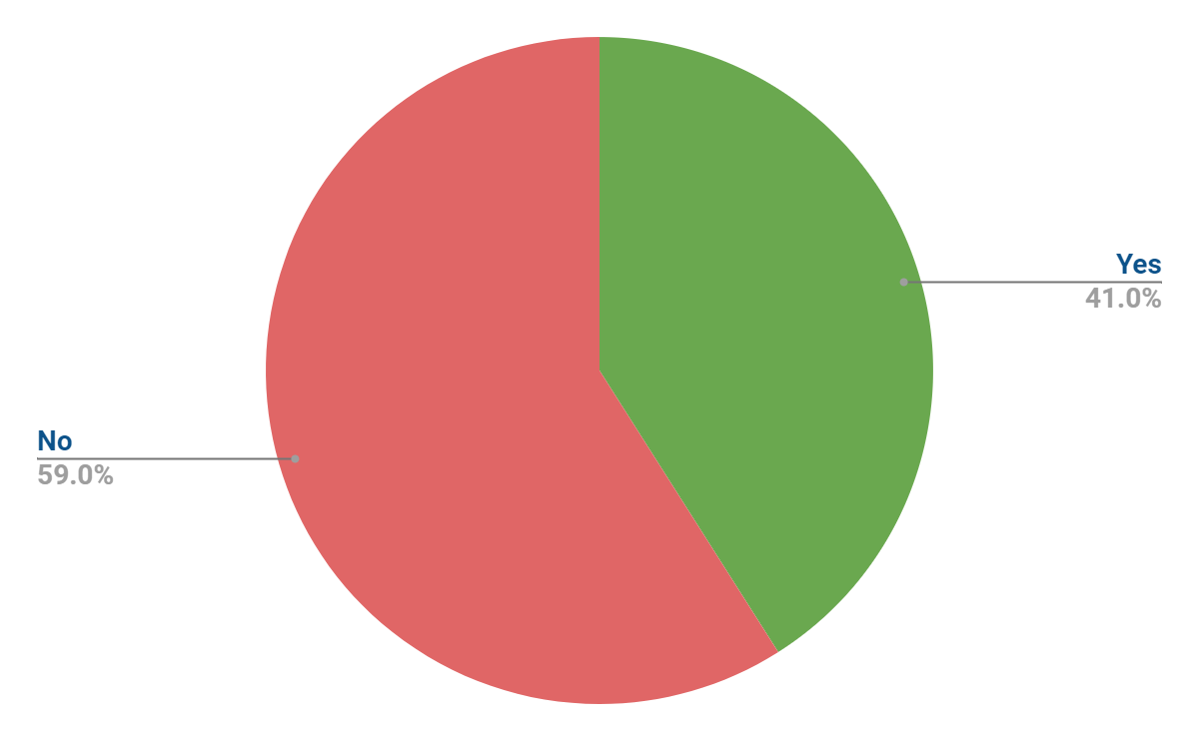
Users’ expectations
Would you pay an annual fee to access a social media website?
Would you pay an annual fee to access a news website?
Average fee: 17 euros
Average fee: 18 euros

Slide 12
A real choice or a false dilemma?
Financial aspects
Technical aspects
Online content/services are available at low or no cost because of advertising
What are the limits for online platforms when shaping their business model?
Behavioral advertising is imposed by (Very) Large Online Platforms
Is advertising with less or no personal data, e.g. contextual a possible solution?

Slide 13
A real choice or a false dilemma?
Social aspects
Legal aspects
Users are not used to paying a fee for online services/content
Users are usually unaware of the risks of OBA and make uninformed decisions
There is already a third option (?) Stop using Meta services!
Interplay of consumer and data protection rules:
Consent + Contract ?
Transparency for Genuine Choice?
Necessity and proportionality: Not only about how but also who

Slide 14
Thank you!
Vassilis Karkatzounis | Dr. Evangelos Margaritis

